Slide 1

Red Team to Blue Team: A Web Application VAPT with a SIEM Roadmap

Slide 2
End-to-End Cybersecurity Pipeline: Web App Pentesting And SIEM Threat Hunting
What is this project about?
This is a complete cyber security project where I take the role of both an attacker (red team) and a defender (blue team):
First, I hacked into a fake web application (legally) to find vulnerabilities — this is called Web Application Penetration Testing (VAPT).
Then, I used a SIEM (Security Information and Event Management) tool to monitor attacks and analyze logs in real-time — this is Threat Hunting.

Slide 3
1. Web Application VAPT (Offensive Security)
What I did:
Deployed vulnerable apps: DVWA (Damn Vulnerable Web App)
Set them up on local VM.
Used tools to find and exploit bugs: Burp Suite – intercepting/modifying requests, Nmap – port scanning, Discovered vulnerabilities: SQL Injection,Cross-Site Scripting (XSS), Broken Authentication, IDOR, etc.
Outcome: Created a detailed VAPT report with screenshots, exploit steps, and remediation suggestions.

Slide 4
2. SIEM Log Analysis & Threat Hunting (Defensive Security)
What I did:
Installed Wazuh SIEM (locally or on cloud)
Set up log forwarding from:
  The vulnerable app machine
  The attacker machine (Kali Linux)
Simulated attacks:
  Brute-force login
  Reverse shell
  Privilege escalation
Used MITRE ATT&CK framework to identify and tag attack techniques
Analyzed alerts and created a Threat Hunting Report
Tools Used: Wazuh, Filebeat, Sysmon/auditd, MITRE ATT&CK, Kibana

Slide 5
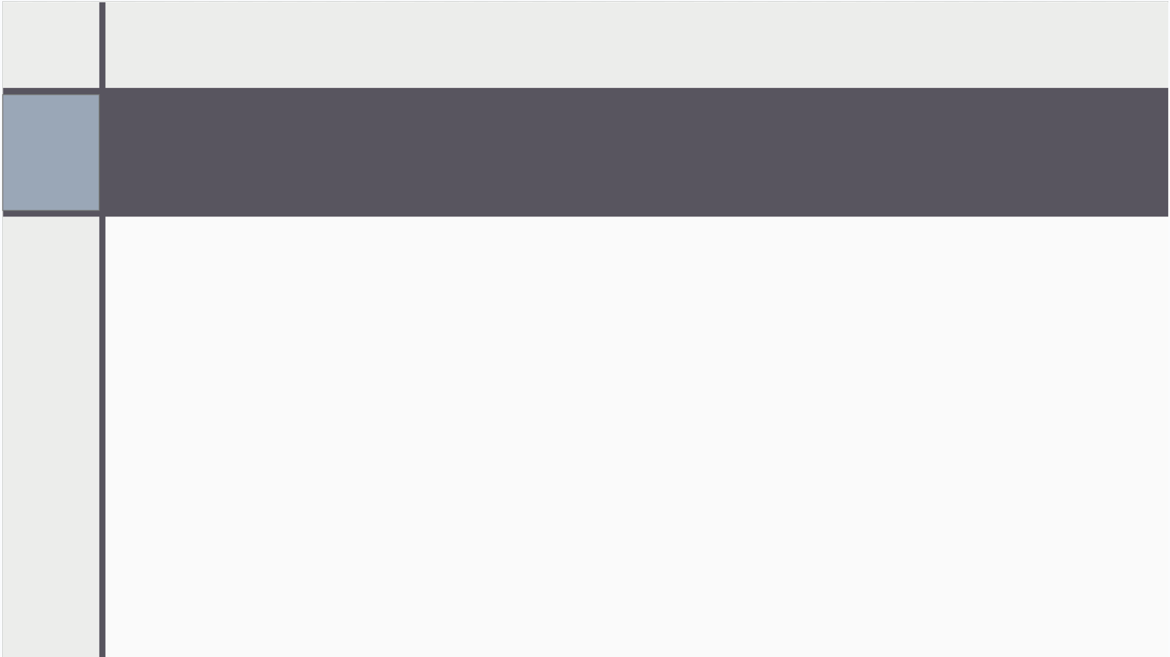
FOR WEB APPLICATION VULNERABILITY TESTING
TOOLS USED - NMAP ( NETWORK MAPPER)
Nmap (Network Mapper) is an open-source network scanning tool used to discover devices, identify open ports, detect services and their versions, and gather information about operating systems on a network.
Network Discovery: With Nmap, users can scan networks and discover devices and hosts on a network, allowing network admins to understand the network more efficiently.
Port Scanning: It can determine which ports are open and which services are running on those ports, which is critical for security assessments and vulnerability scanning.
OS Fingerprinting: Nmap can attempt to identify the operating system running on a target host by analyzing various characteristics of network packets.
Vulnerability Assessment: It's a valuable tool for identifying potential vulnerabilities in systems and services, aiding in proactive security measures.
Network Monitoring: Nmap can be used for continuous monitoring to detect changes in the network environment.

Slide 6

2. TOOLS USED - BURP SUITE
Burp Suite acts as a proxy between your browser and the web server. This means it can intercept and inspect the data sent between your browser and a website. By doing this, you can, see exactly what your browser is sending, modify requests to test for vulnerabilities and analyze responses from the server.
Why Burp Suite is Important
Web apps are everywhere (banks, social media, e-commerce).
Hackers exploit weaknesses in web apps.
Burp Suite helps ethical hackers identify and fix vulnerabilities before bad actors can exploit them.

Slide 7
2. TOOLS USED - BURP SUITE
. Main Components
Proxy
  Intercepts HTTP/S requests and responses.
  Lets you modify requests before they reach the server or responses before they reach the browser.
  Useful for testing how a server reacts to unexpected or malicious input.
Repeater
  Allows you to manually send requests multiple times.
  You can change parameters to test how the application behaves.
  Example: Change ?id=1 to ?id=2 or try SQL injection payloads.
Scanner (in Burp Suite Professional)
  Automatically scans for vulnerabilities like XSS, SQL injection, etc.
  Very useful for speeding up testing.
4. Intruder
  Automates sending lots of requests with different payloads.
  Useful for testing login forms (brute-force) or input fields.

Slide 8
2. TOOLS USED - BURP SUITE
5. Sequencer
  Analyzes the randomness of tokens (like session IDs or CSRF tokens).
  Checks if tokens can be predicted.
6. Decoder
  Encodes or decodes data (like Base64, URL encoding, etc.).
  Helps understand hidden or encoded data in requests.
7. Comparer
  Lets you compare two pieces of data to find differences.
  Useful for analyzing responses before and after a change.

Slide 9
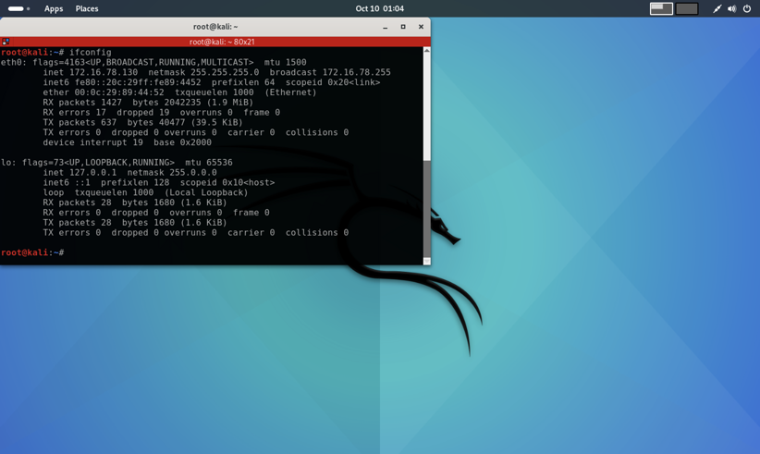
Pre- Vapt snapshot
KALI VM’s IP - 172.16.78.130

Slide 10
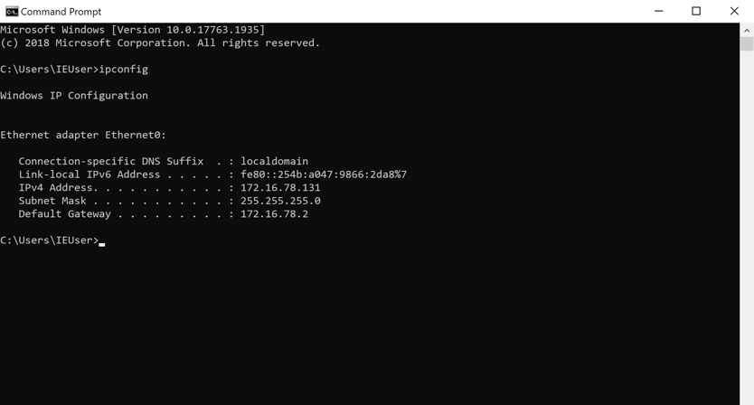
Windows ip (target machine) – 172.16.78.131

Slide 11
We will use burp suite. It is a powerful tool for testing and attacking web applications. It sits between your browser and web server and gives you tools to inspect, modify, automate and analyse web traffic and vulnerabilities.
First we will ensure that burp is listening on 127.0.0.1:8080. In Burp : Proxy -> options -> under proxy listeners for 127.0.0.1:8080. This is the port your browser will send traffic to so Burp can capture it.
Then configure your browser to use Burp as proxy. The browser that we are using is FireFox. Open firefox in Kali, In firefox: preferences -> search for network settings-> click settings-> choose manual proxy configuration and set HTTP Proxy 127.0.0.1 and port 8080. After this every page in the firefox session will go through burp.
Burp is listening on Kali because it is running on Kali and acts as a proxy for whatever browser you use that sends traffic to it.
Next we’ll test if Burp sees traffic. In Burp go to proxy -> intercept and ensure intercept is off so burp is normal and just log requests. In the proxied firefox open http:/172.16.78.131/dvwa. After that go to Burp -> proxy -> HTTP history.
Workspace organisation ( Create these folders on Kali )

Slide 12
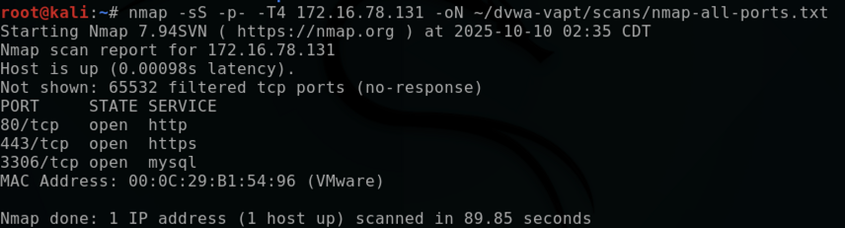
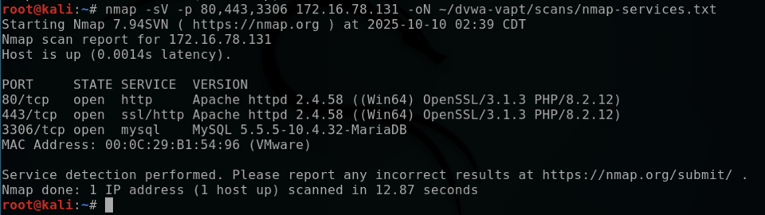
Phase 1 - Reconnaissance and Mapping ( Day - 1)
Goal: Enumerate ports, services, web endpoints and collect a list of parameters to test.
Nmap - Find open ports and service versions
-sS : Stealthy scan/ half SYN scan
-p- : scan all 65535 ports
-T4 : Faster Timing
-oN : save result
Then run a service/ version scan on web ports you discovered
-sV : Service/ Version detection

Slide 13
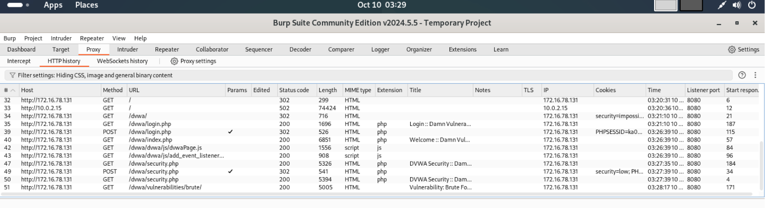
First, launch DVWA and change the security setting to 'Low'. Next, open Burp Suite, disable Intercept, and examine the HTTP history; Burp will capture and store all requests and responses while intercept is disabled
After submitting a few forms in dvwa

Slide 14
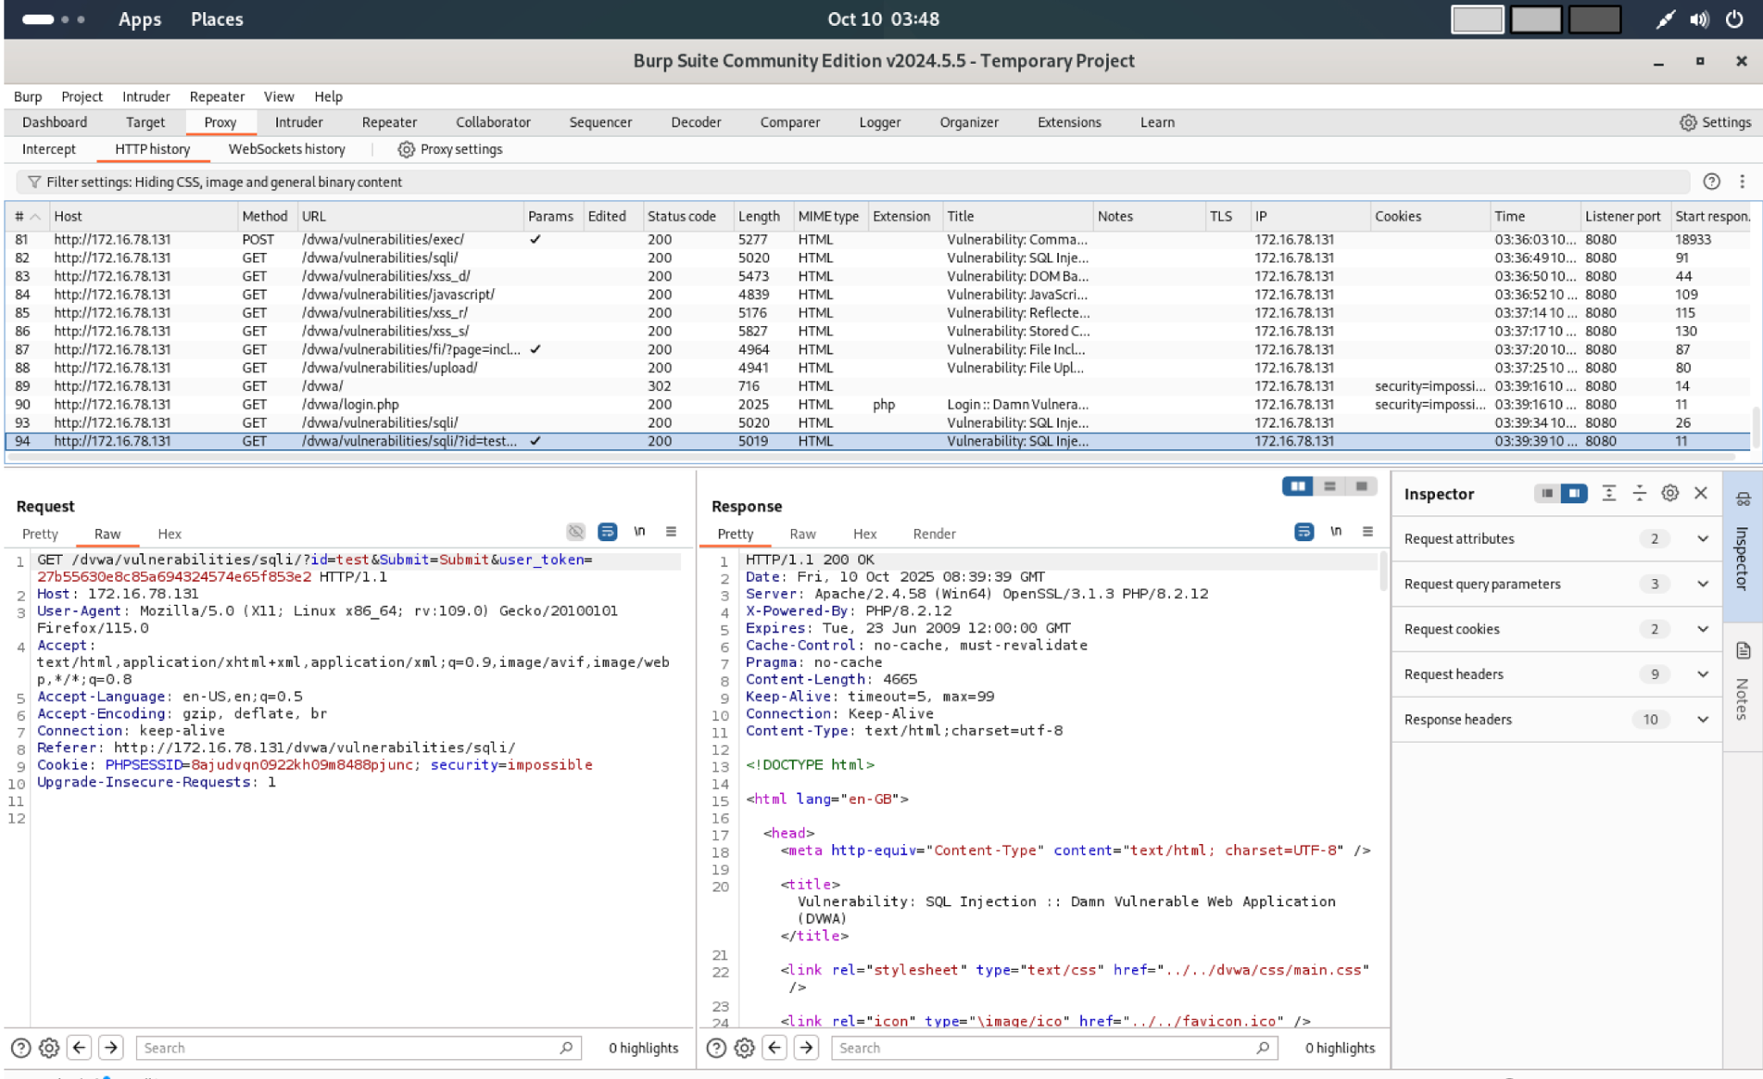
For each page, record the URL, HTTP method, and any parameters. Click through every page of the DVWA site, including each vulnerability module. For example, open the SQL Injection module. Then in Burp Suite go to Proxy → HTTP history, find the request to Vulnerabilities → SQLi, select it, and inspect the Request panel to view the raw HTTP request.

Slide 15
ATTACK - 1 : SQL INJECTION ATTACK
It is a web vulnerability that happens when user input is directly included in a SQL query without being properly sanitized.
Suppose a login form runs : SELECT * FROM users WHERE username = ‘user’ AND password = ‘pass’
If you enter ‘ or ‘1’ = ‘1 then the query become SELECT * FROM users WHERE username = ‘ ‘ or ‘1’ = ‘1’ AND password = ‘’
‘1’ =’1’ is always true so the query returns all users -> login bypass.
Types of SQL injection:
In‑band SQLi — the application returns data or errors directly in the response. (Easier and faster.)
Union‑based
Error‑based
Inferential (Blind) SQLi — no direct data in responses. You infer data via behavior or response time.
Boolean (content)‑based blind
Time‑based blind

Slide 16
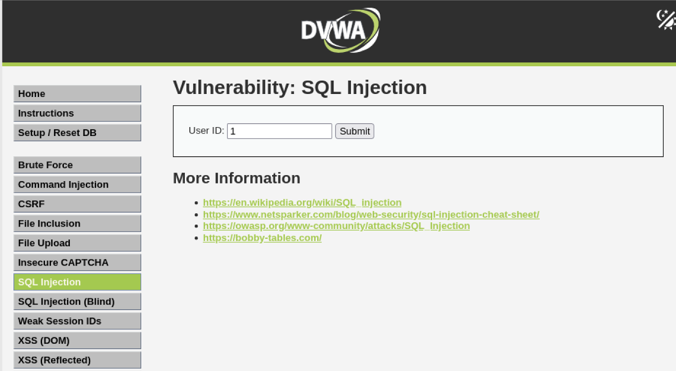
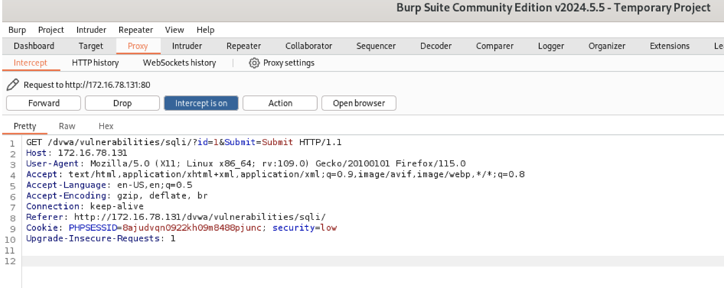
PERFORMING SQL INJECTION:
OBJECTIVE : STEAL USERS USERNAME AND PASSWORD
Step 1: Open DVWA SQL injection module. You will see a page like this. Keep intercept ON in Burp. Enter any number and click submit. Burp will catch the request and then send it to the repeater.
Next we will change the parameter in Burp Repeater one by one and click send.
Our next input will be 1’ or ‘1’=’1’ –. This will render all the user records present in the database.
Returning "all rows" doesn't mean you can see sensitive data — depends on what columns the original query selected.

Slide 17
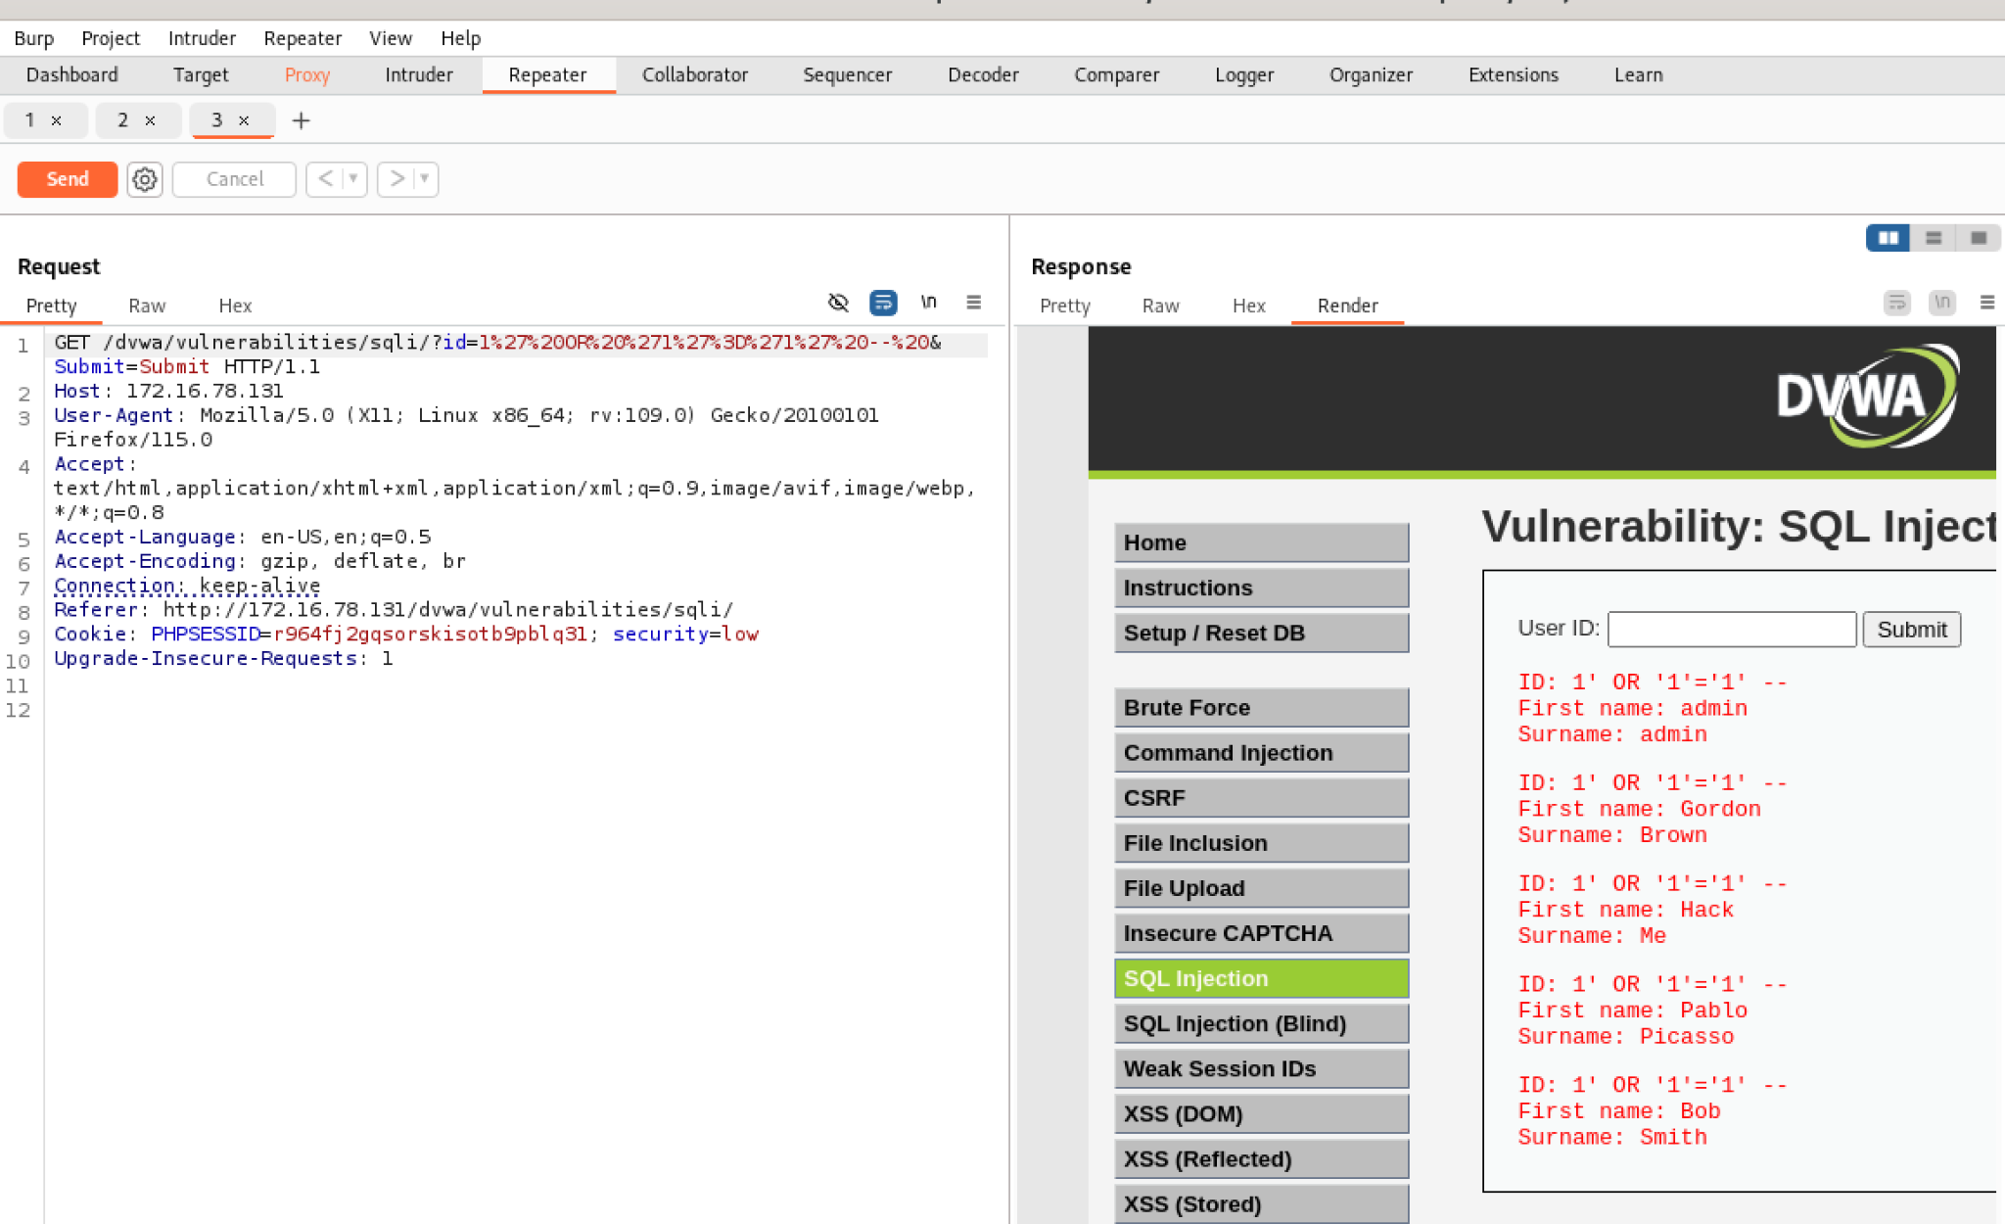

Slide 18
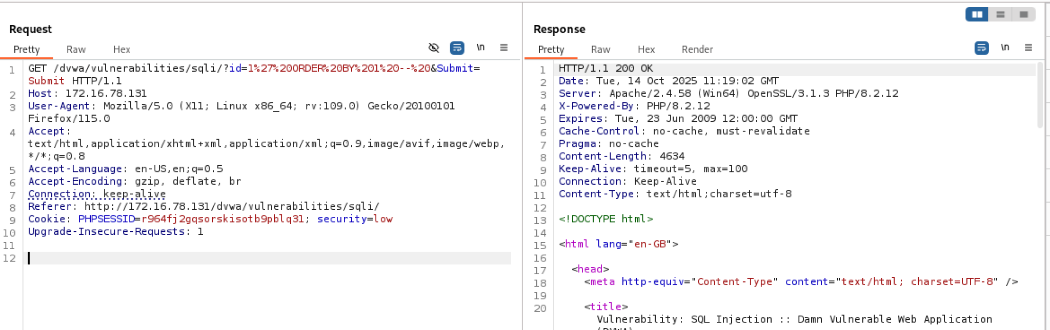
Next goal: make the server return specific values (like user(), database(), or username/password) by using UNION SELECT or by mapping columns.
STEP 1: UNION merges result sets if each SELECT returns the same number of columns and compatible types. If not, DB raises an error: All queries combined using UNION must have the same number of columns.
STEP 2: Find the number of columns, there are two methods ORDER BY and UNION NULLS .
Ex: -- server-side template (before injection) : SELECT id, username, email FROM users WHERE id = <YOUR_INPUT>;
server-side template (after injection) : SELECT id, username, email FROM users WHERE id = 1 ORDER BY 3-- ;
So if in order by n : If n is greater than the number of columns, SQL throws an error → page shows an error (or a different behavior depending on the web app), which means the no. of columns is less than n. Also -- is used to comment everything after.
So my payload will by for example id = 1 0RDER BY 1–
Since in my case 0RDER BY 10000- also works then we would assume that my injection is not reaching database.
So we will try 1’ 0RDER BY 1-- , Since this also didn’t give any error we will proceed with method 2.

Slide 19
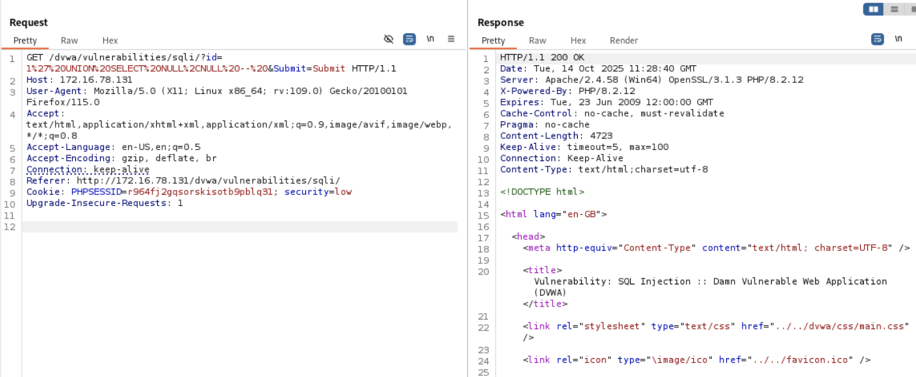
We will use something like this 1' UNION SELECT NULL,NULL –
We will start with : 1 column : 1%27%20UNION%20SELECT%20NULL%20--%20
: 2nd column : 1%27%20UNION%20SELECT%20NULL%2CNULL%20 and then so on.
No error = UNION accepted. That usually means the original query returns 2 columns
No visible marker = accepted but page didn’t print those columns

Slide 20
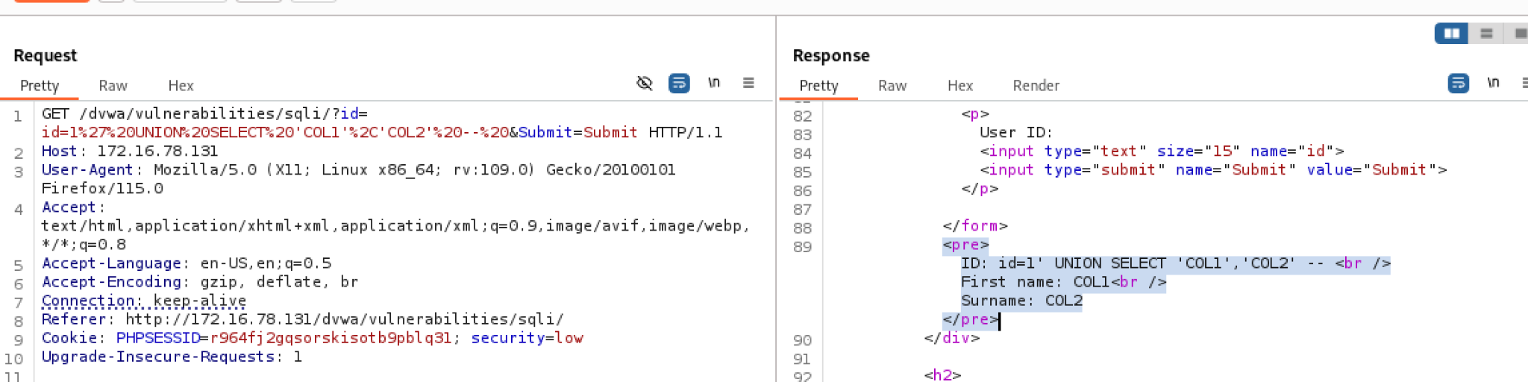
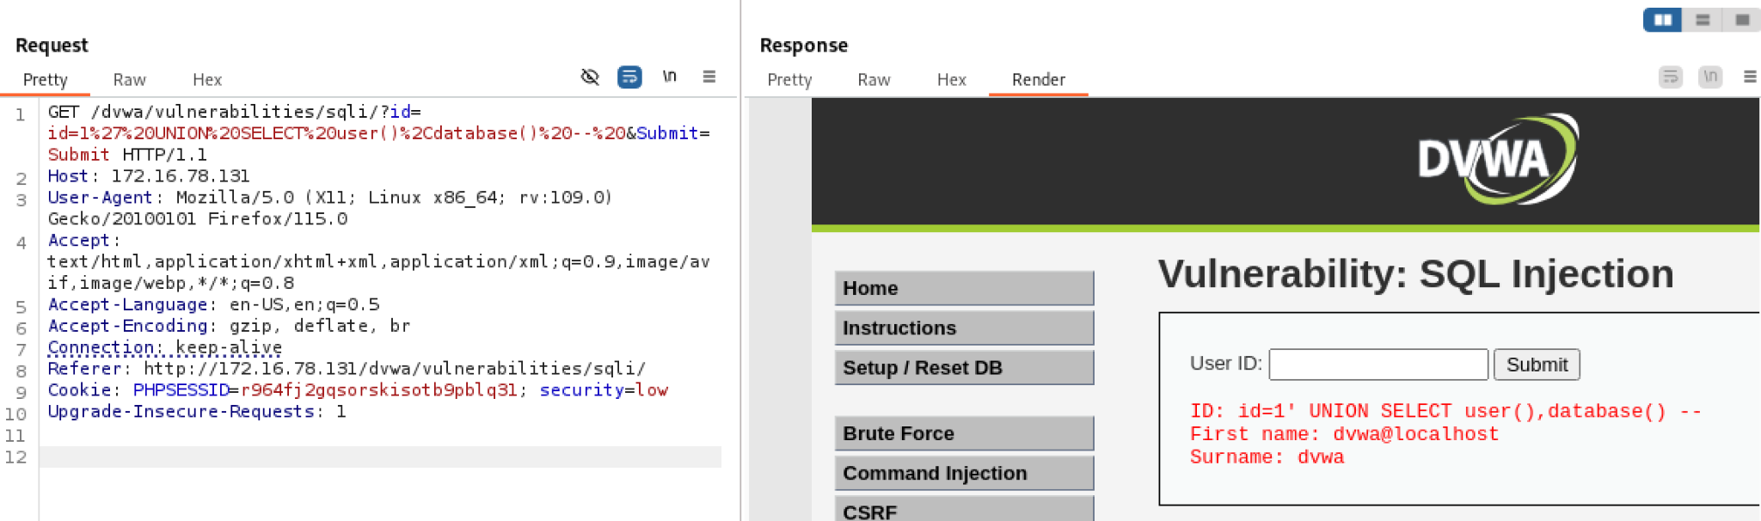
1) Map which UNION column is visible
Since both COL1 and COL2 is visible. That means a 2‑column UNION maps directly to the two visible fields (First name / Surname). You can now make the DB return whatever values you want in those two visible spots. So now we can show database user and database name

Slide 21
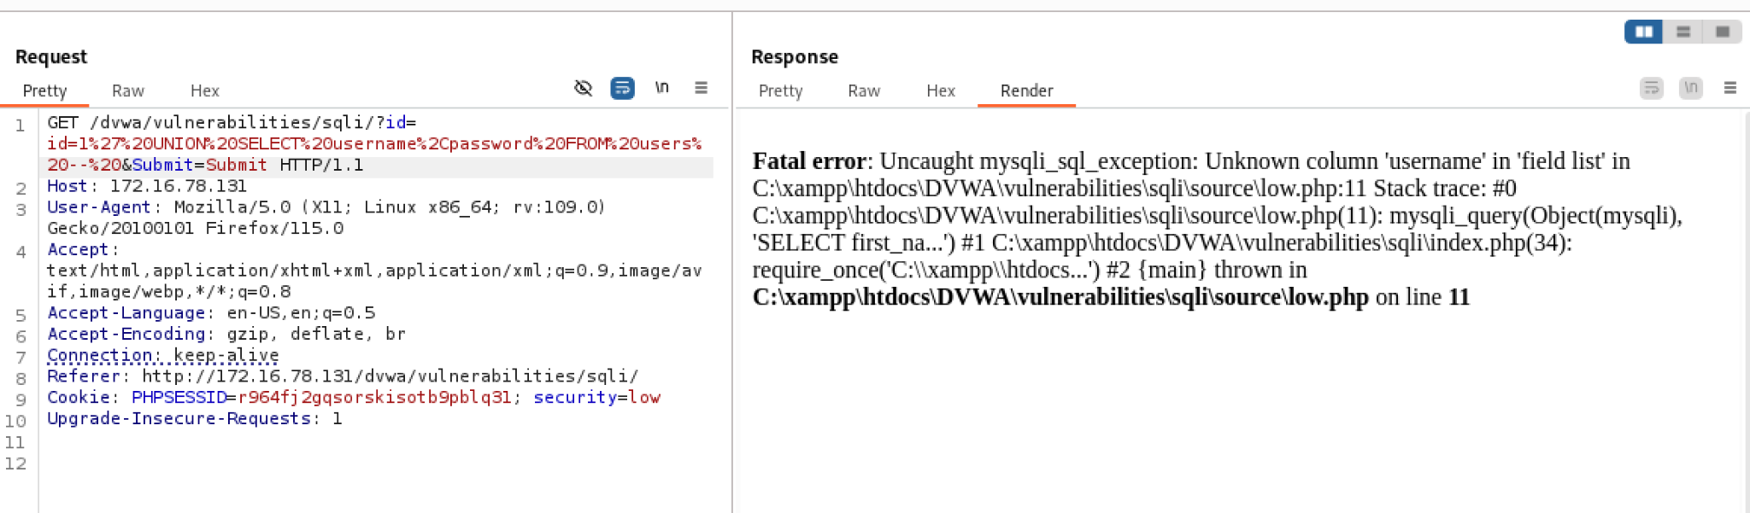
Next thing we will try is to pull username & password from users table (manual attempt)
If DVWA’s DB has a users table (it usually does), try returning username and password directly:
Since this didn’t work we will try a different approach that is, Sometimes username/password types or how values are rendered causes problems. Put both into a single visible column with CONCAT:
0x3a is : — you'll see username:password ( used in the next picture )

Slide 22
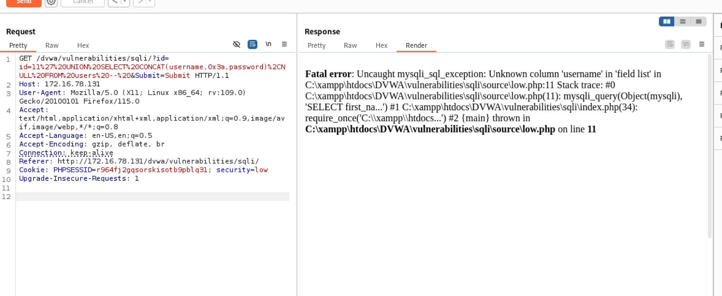
This also didn’t work since username column doesn’t exist so now we have to find the column name first.

Slide 23
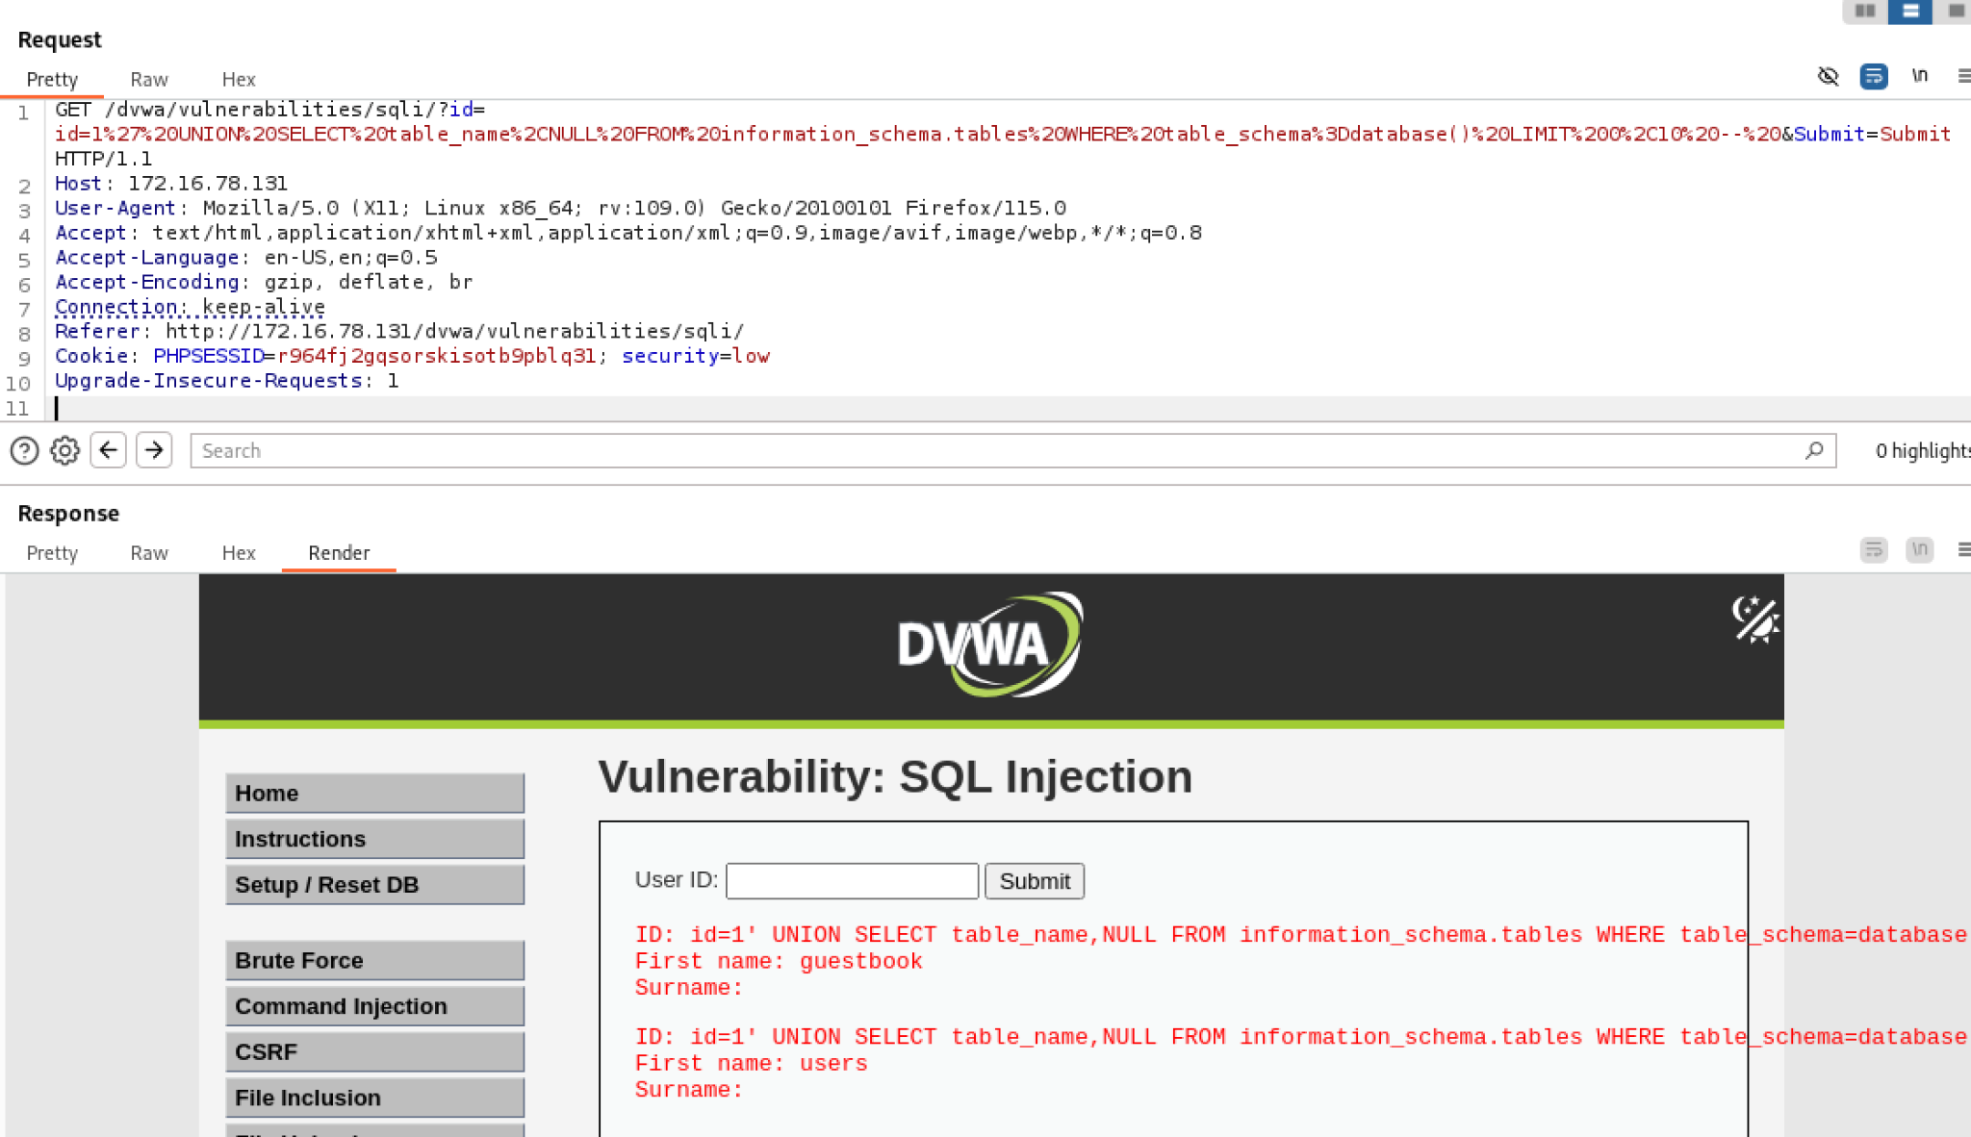
2) Enumerate table names (use information_schema) — list a few table names

Slide 24
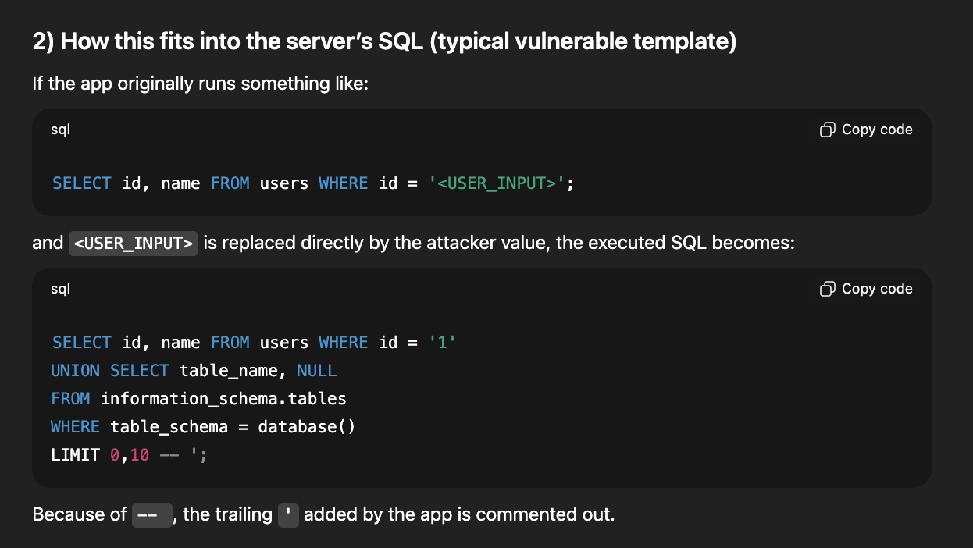
The explanation of the above code in readable format and how it fits in server sql

Slide 25
1'
Closes the server’s opening quote (breaks out of the intended string literal). This is the classic way to escape a quoted context.
UNION SELECT table_name, NULL
Uses UNION to combine results of the original SELECT with attacker-supplied rows. The attacker selects table_name (first column) and NULL (second column) so the injected SELECT returns two columns, matching the original SELECT id, name which returns two columns. NULL is a safe, type-agnostic placeholder.
FROM information_schema.tables
information_schema.tables is the standard metadata table in MySQL (and many RDBMS) that lists all tables in all schemas/databases. This lets the attacker enumerate table names.
WHERE table_schema = database()
Filters rows to only those in the current database. database() is a MySQL function that returns the current DB name; this prevents leaking tables from other schemas.
LIMIT 0,10
Returns only the first 10 rows — useful to avoid huge output and to paginate extraction if needed.
--
MySQL single-line comment (dash-dash followed by space). It comments out the rest of the original query so any trailing syntax (like the closing ' or additional clauses the app appends) won’t break the injection.

Slide 26
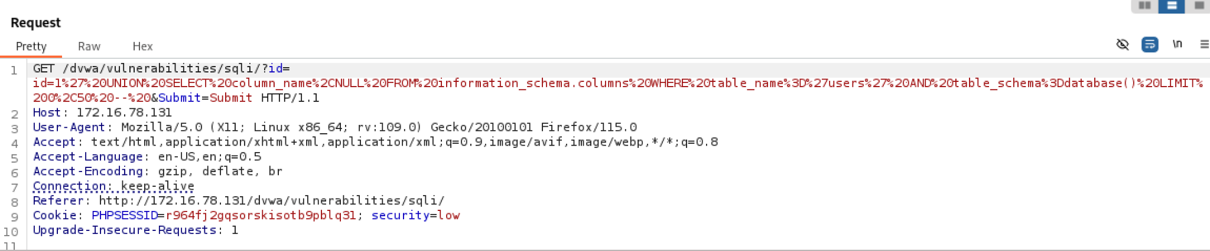
We found two real tables: guestbook and users. Next step: list the columns for the users table, then extract the username/password values.
Use information_schema.columns to list columns for the users table:
The code that will be written in id is: ?id=1' UNION SELECT column_name,NULL FROM information_schema.columns WHERE table_name='users' AND table_schema=database() LIMIT 0,50 -- &Submit=Submit.

Slide 27
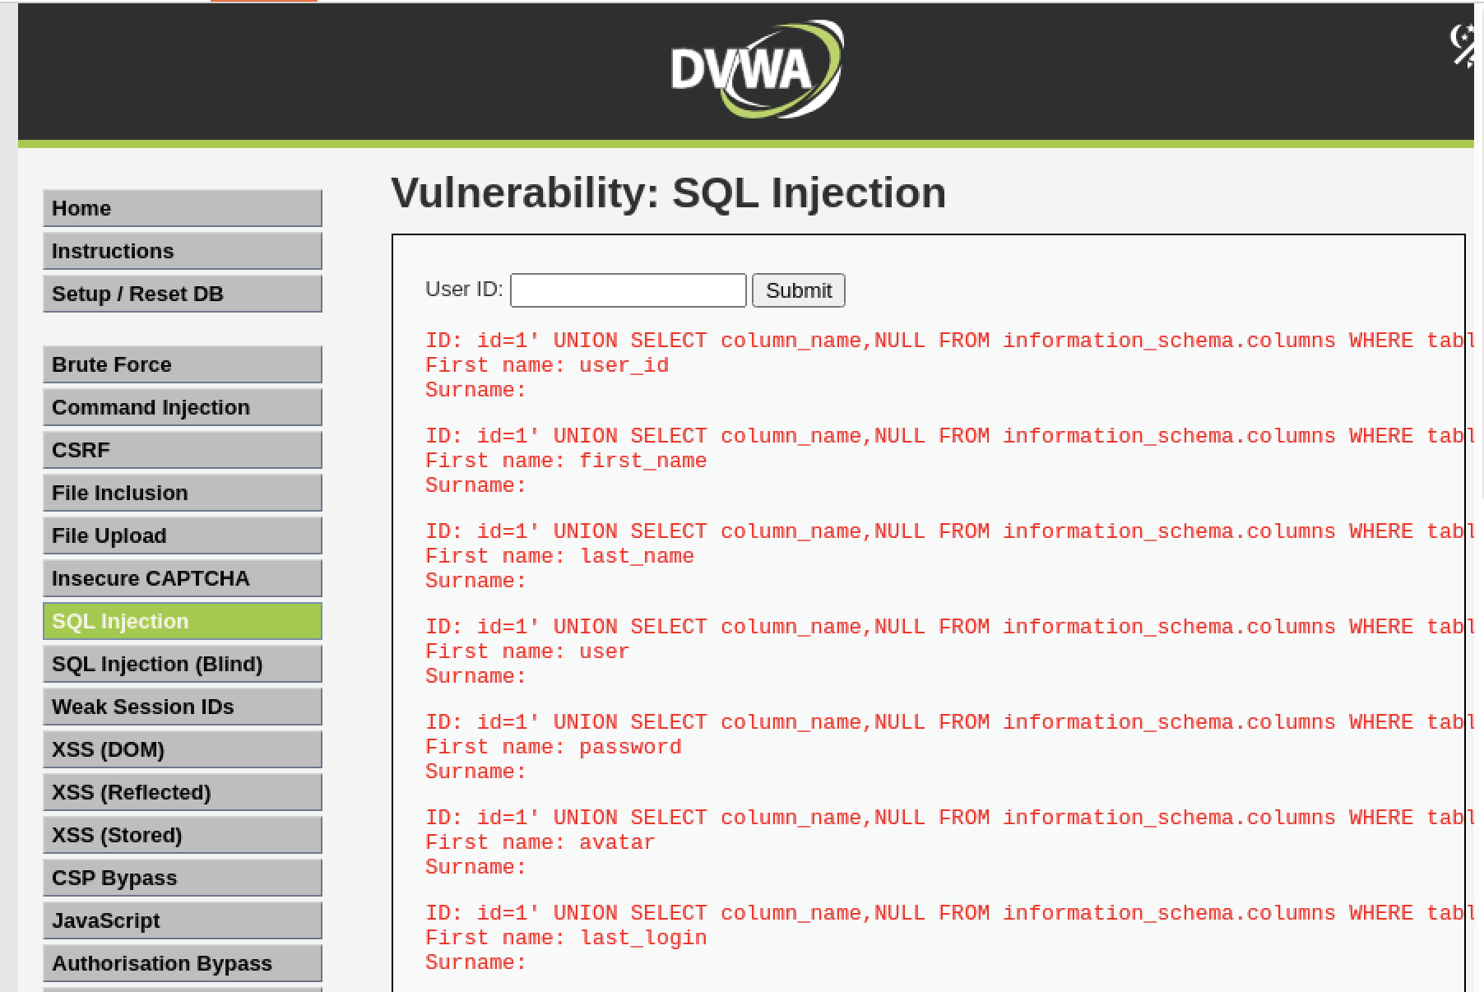

Slide 28
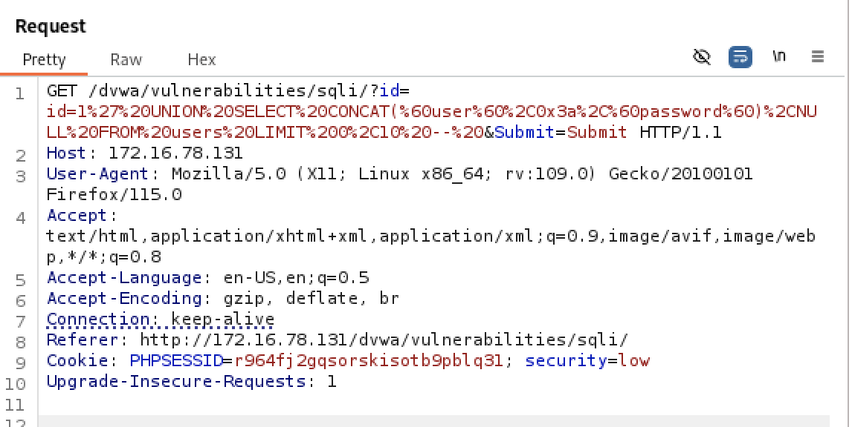
Since we have all the columns listed now, we will try to extract the user and password.
The human readable code is : 1' UNION SELECT CONCAT(`user`,0x3a,`password`), NULL FROM users LIMIT 0,10 --

Slide 29
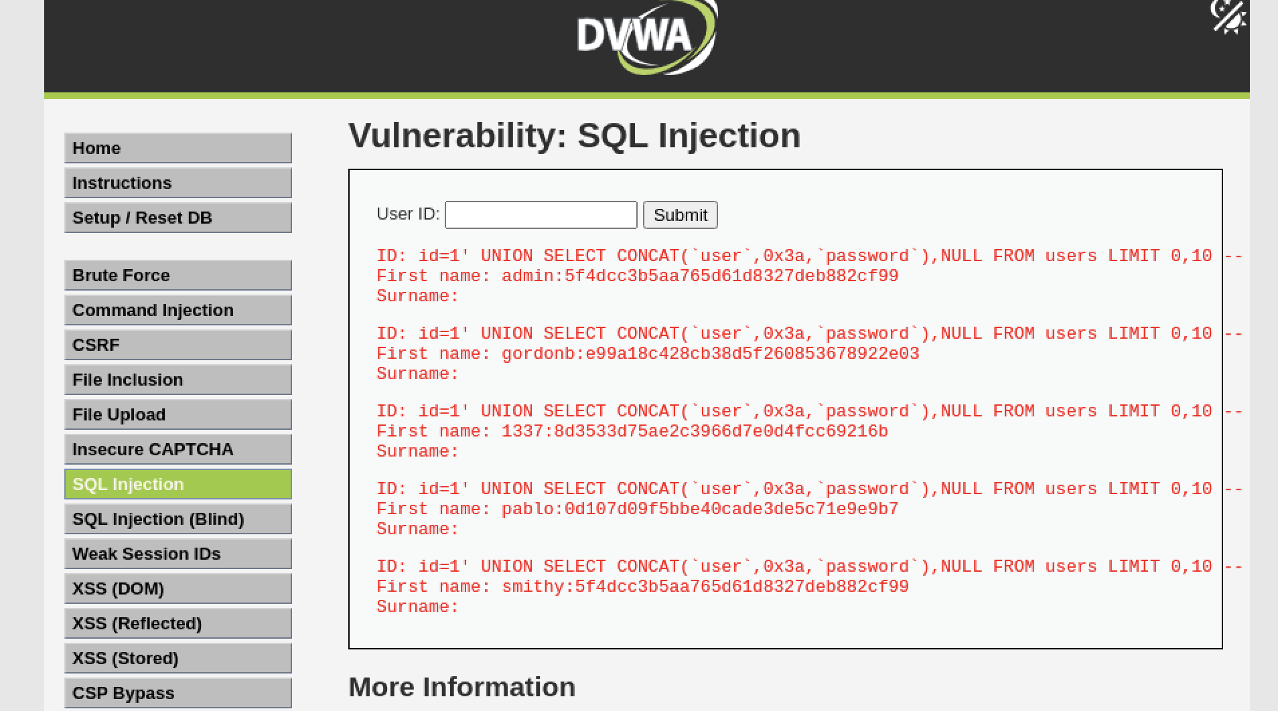

Slide 30
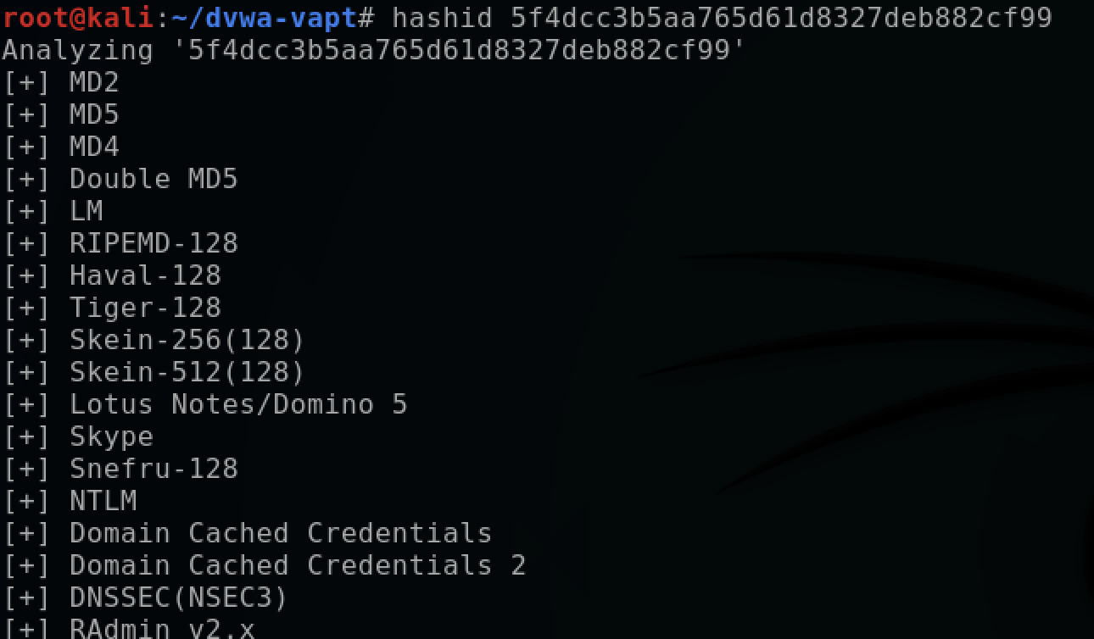
I got the username and hashed password. So now we will try to crack the hashed password.
First we will store all the user and hashed password in hash.txt file in dvwa-vapt folder in kali linux.
Next we have to identify the hash type we can do that by: hashid <hash>
hashid simply lists all plausible algorithms that match the hash’s pattern (length, charset, structure). Since we are attacking dvwa we know its MD5.

Slide 31
You can make a file with only hashes (one per line) if preferred:
We will use hashcat or john the ripper to decrypt the passwords. In this case we use John the ripper. First we need to install both of them.
Hashcat
A fast, GPU‑accelerated password‑recovery tool.
Excellent for large, brute‑force or wordlist+rule attacks (MD5, NTLM, mscash/mscash2, bcrypt, many formats).
Uses OpenCL/CUDA to run on GPUs — if you have an NVIDIA/AMD GPU, Hashcat is much faster than CPU tools.
You tell it the hash mode (-m) and attack type (-a), give it a wordlist and/or mask/rules, and it tries guesses.
John the Ripper (John / John Jumbo)
A versatile password cracker that runs comfortably on CPU (and can use GPUs in some builds).
Great for quick CPU-based testing and for cases where format auto-detection and simple setup are useful.
John’s --show/potfile handling and format options make mapping user:hash → user:password easy.
When to use which:
Use Hashcat when you have a GPU and need speed/scale.
Use John for quick CPU tests, format detection, or convenience on small tasks.

Slide 32
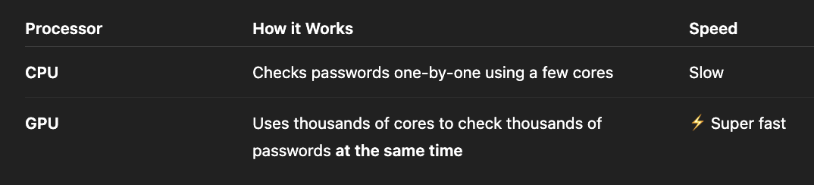
CPU (Central Processing Unit) :
Executes all the general-purpose tasks (running OS, browsers, apps, etc.)
Handles logical, mathematical, and control operations.
Executes one or few complex tasks at a time, very efficiently.
Example: When you open a browser:
The CPU reads instructions (open window, load tab).
It asks the RAM for data (like web page code).
Executes instructions, sends results to the screen.
GPU (Graphics Processing Unit) : The GPU is like a specialized helper for the CPU — built to handle massively parallel tasks. Example: Password Cracking : Let’s say you’re cracking 1 million password hashes.
GPU Drivers : A GPU driver is software that lets your operating system communicate with the GPU hardware. Without the driver, your OS won’t understand how to use the GPU. Example : (company -NVIDIA) - ( driver name - CUDA, NVIDIA DRIVER) etc.

Slide 33
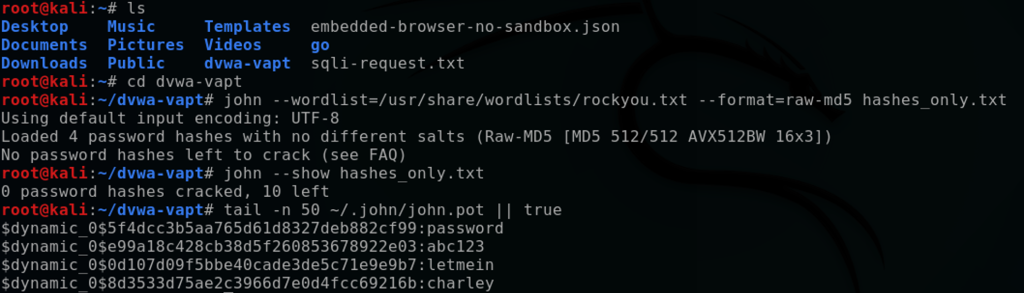
Install on Kali Linux — exact commands
Open a terminal and run these in order. They install Hashcat and John, OpenCL runtime support, wordlists, and (optionally) NVIDIA drivers.
sudo apt update
sudo apt upgrade -y
sudo apt install -y hashcat john ocl-icd-libopencl1 ocl-icd-opencl-dev (These OpenCL (Open Computing Language) drivers — they allow tools like Hashcat to talk to your GPU, regardless of brand (NVIDIA/AMD)).
sudo apt install -y seclists wordlists
# Decompress rockyou if present as gz
sudo gzip -d /usr/share/wordlists/rockyou.txt.gz 2>/dev/null || true

Slide 34
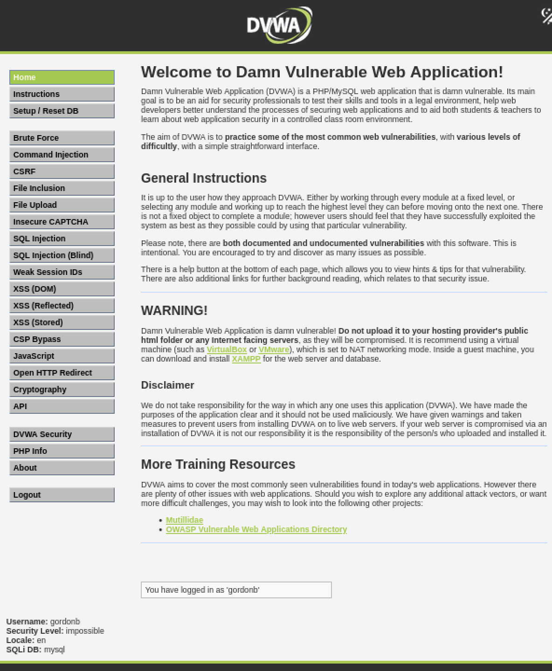
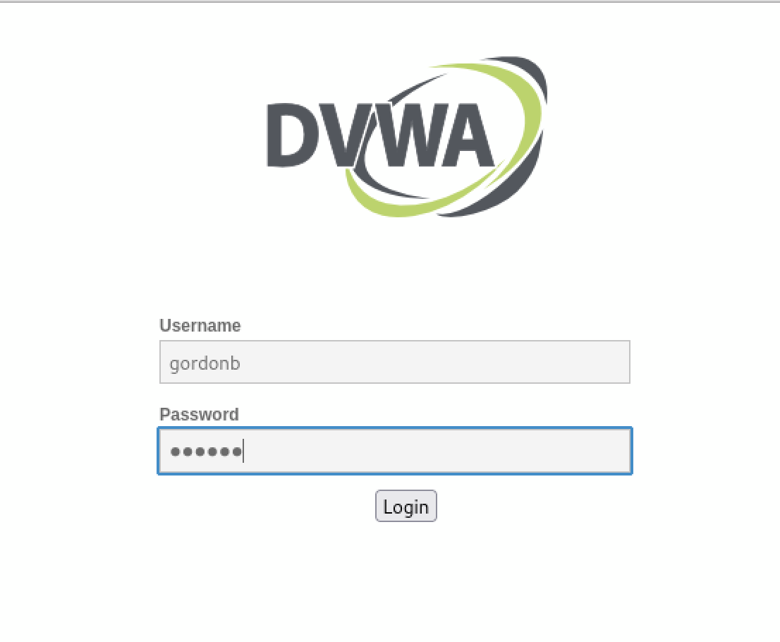
So for eg for : user the password is password
: gordon the password is abc123, so using this user and password we can log into there user account.

Slide 35
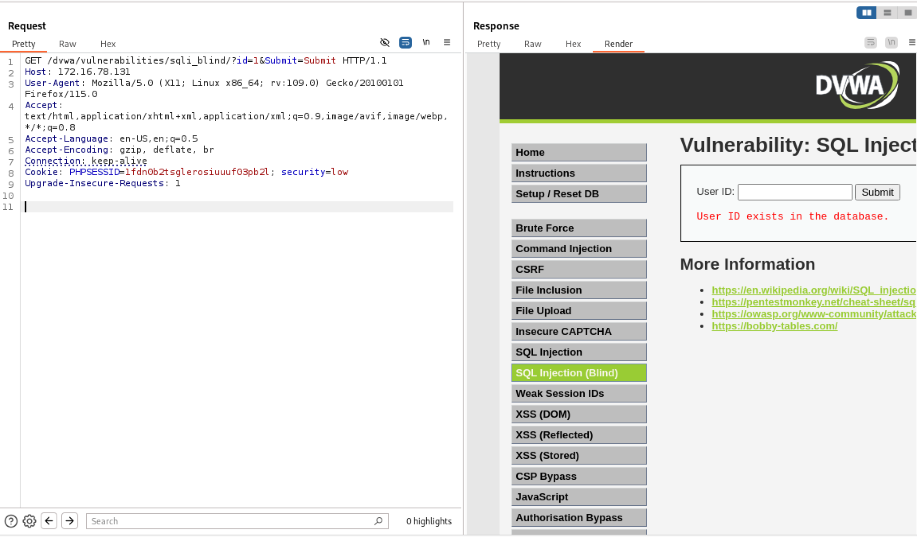
BLIND SQL INJECTION
Blind SQL (Structured Query Language) injection is a type of SQL Injection attack that asks the database true or false questions and determines the answer based on the applications response
Boolean blind: server returns different page content depending on a true/false condition (no visible DB output).
Time‑based blind: server delays response when condition is true (useful when content doesn’t change but timing does).
Both let you extract data one bit/character at a time.

Slide 36
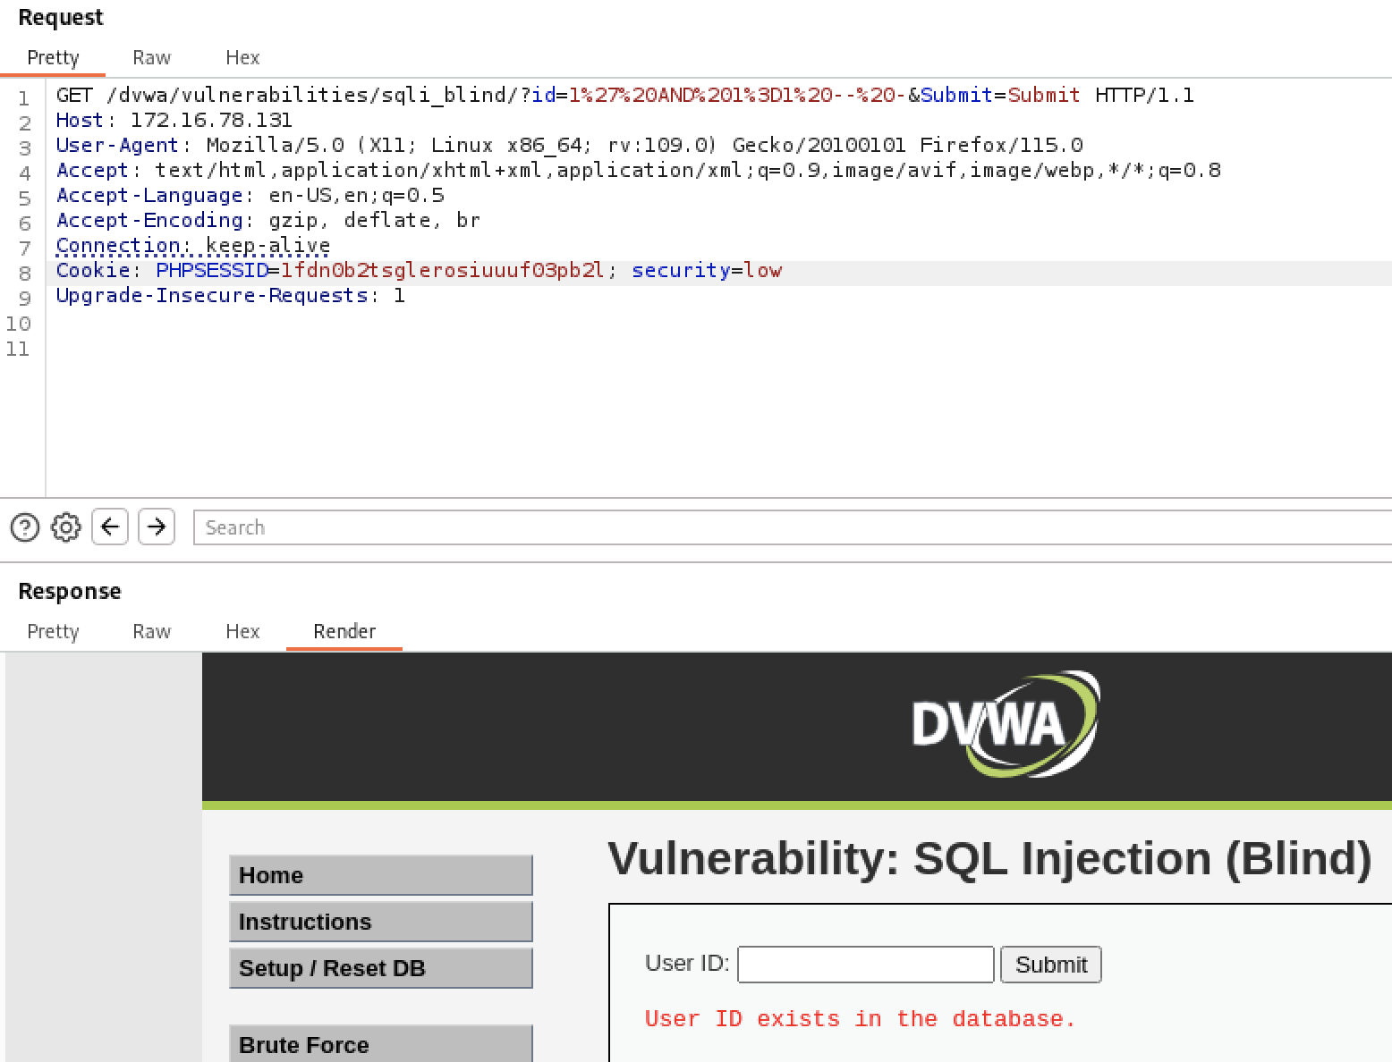
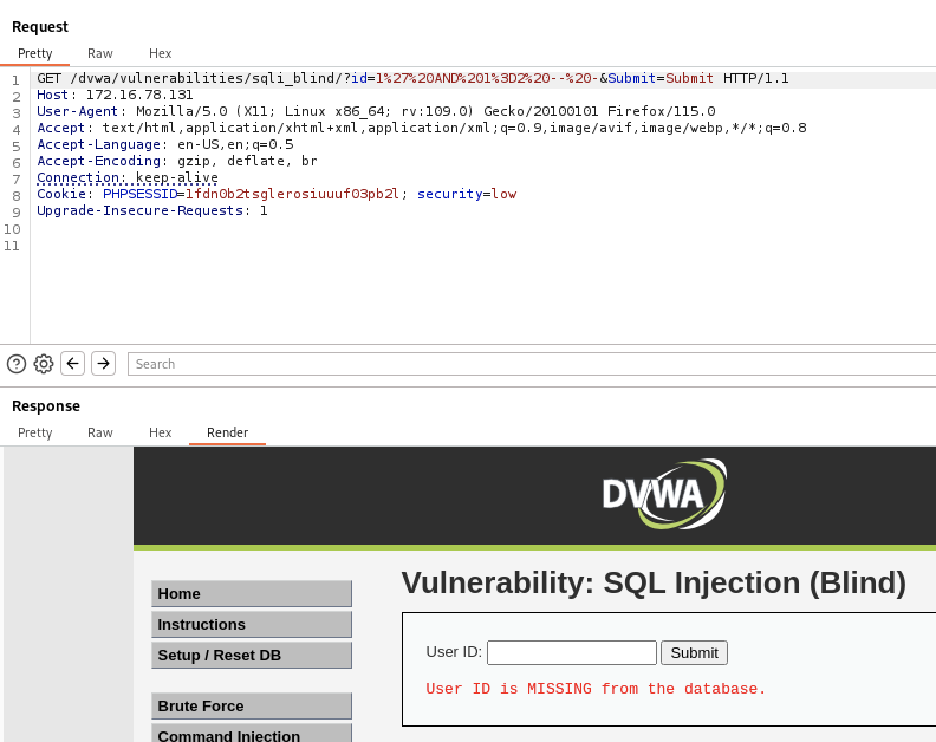
Detecting blind injection (quick tests)
A. Boolean test (try to change page content):.
Test true/false payloads (MySQL example):
  True: id=1' AND 1=1 -- -
  False: id=1' AND 1=2 -- -
Send both via Repeater. If page output differs (content, length, presence/absence of some text), you have boolean blind.

Slide 37
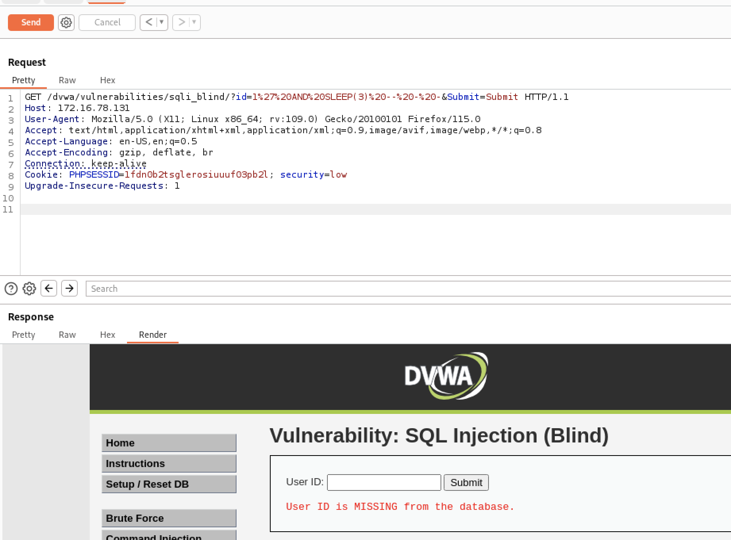
B. Time test (if no content change):
MySQL quick time test: id=1' AND SLEEP(3) -- -
If response is ~3s slower vs baseline, you have time-based blind injection.
If neither works, try different encodings or test POST body. Once you confirm at least one works, proceed.

Slide 38
Time‑based blind — basic extraction (MySQL example)
We’ll extract the first character of database() to illustrate.
Payload structure explanation
We craft a condition that, if true, causes a delay (SLEEP). Example:
1' AND IF(condition, SLEEP(5), 0) -- -
If condition is true, server waits 5s → visible in response time.
Exact payloads (MySQL) : Test condition (first char = 'a')
id=1' AND IF(ASCII(SUBSTRING((SELECT database()),1,1))=97, SLEEP(5), 0) -- -
If response time ≈ baseline + 5s → first char = 'a'. If not, try ASCII 98 ('b'), etc.
Boolean‑based blind — basic extraction (example)
Boolean returns allow checking equality without timing.
Payload example (MySQL)
Check if first char is 'a':
id=1' AND (ASCII(SUBSTRING((SELECT database()),1,1))=97) -- -
If page content changes to the “true” state, character is 'a'. If not, it's not 'a'.
Boolean tends to be faster (no delays) but requires a visible difference in response.

Slide 39
Efficient extraction strategy (iterate positions & characters)
Don’t test every ASCII value naïvely — use ordered sets and binary search to reduce requests.
Simple iterative approach (position by position)
For position pos from 1..N:
For each charset character c in abcdefghijklmnopqrstuvwxyz0123456789_:
  Time payload (or boolean) for SUBSTRING(...,pos,1)=c.
  Stop when condition true — that char found.
Faster: binary search on ASCII code (time-based)
Instead of guessing each char, compare ASCII(char) > X to narrow range.
Example payload (check if ASCII > 109):
id=1' AND IF(ASCII(SUBSTRING((SELECT database()),1,1))>109, SLEEP(5), 0) -- -
If delayed → ASCII > 109 → set new range. Repeats ≈ log2(128) ≈ 7 checks per char instead of ~36.
This is very useful if you must extract long strings.

Slide 40
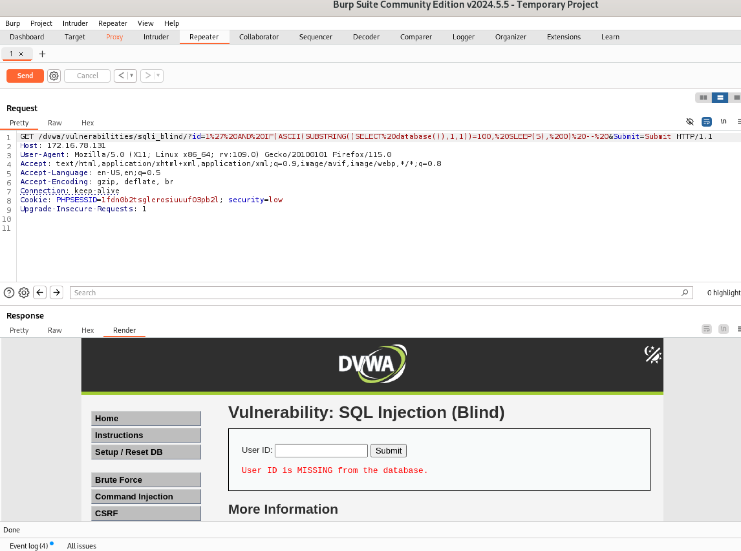
Time based :
The first character is d since at 100 it took more than 5 sec.

Slide 41

Boolean based
At 100 the page’s content changes to true state.

Slide 42
When a web app is vulnerable to blind SQL injection, the app doesn’t show the database output directly. We still want to learn secret info (like the database name).
Time‑based blind SQLi uses the database’s sleep function as a signal: if a guessed condition is true, the DB sleeps for N seconds and the HTTP response is slower.
Burp Intruder automates trying many guesses (letters or ASCII codes). It sends each guess and measures response time. The guess that produces a long response time is probably correct. That’s why we use Intruder: to test many guesses quickly and reliably.
High level workflow (one line each)
Capture a working request that contains the vulnerable parameter.
Send that request to Intruder.
Mark the single spot (the character or ASCII value) to replace.
Provide a list of guesses (a–z or ASCII codes).
Start attack and sort results by Response time.
Confirm the top result in Repeater (manual confirmation).
Move to next position (pos 2) and repeat.

Slide 43
Step 1 — Capture the request (purpose: get the exact HTTP you’ll alter)
What you do:
In the browser, with Burp running, open the vulnerable page (DVWA blind SQLi form).
Intercept the request and right‑click → Send to Intruder.
Why: Intruder needs the real HTTP request so it can modify that request and send variants.
Step 2 — Go to Intruder → Positions (purpose: tell Burp what to change)
What you do:
Open the request in Intruder → Positions tab.
Click Clear § to remove auto markers (we want full control).
Edit the request so the part you want to change is visible. There are two common templates:
A) Character mode (replace a char) — use when you want to try letters directly:
... id=1' AND IF(ASCII(SUBSTRING((SELECT database()),1,1))=ASCII('§'), SLEEP(5), 0) -- - &Submit=Submit
Highlight just the § and click Add §.
B) Numeric ASCII mode — use when injecting ASCII numbers (good for binary search):
... id=1' AND IF(ASCII(SUBSTRING((SELECT database()),1,1))=§, SLEEP(5), 0) -- - &Submit=Submit
Highlight § (the numeric position) and click Add §.
Plain explanation: the § is the placeholder Burp will replace for each guess. We only want one placeholder — one target position at a time.
First I will proceed with A.

Slide 44
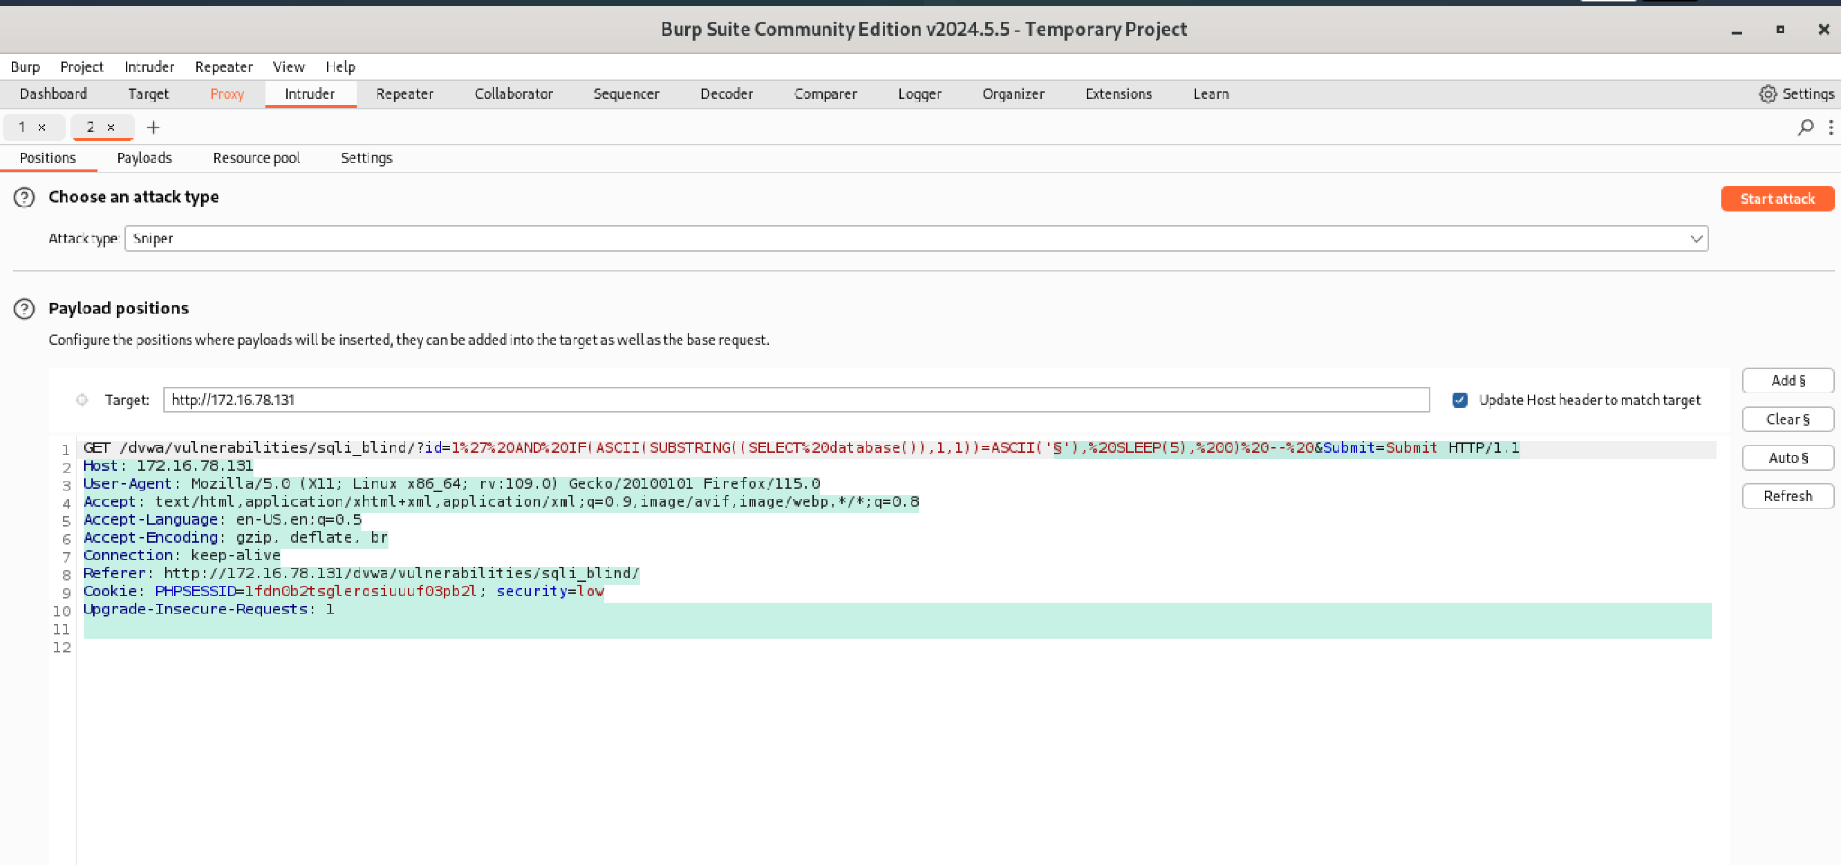

Slide 45
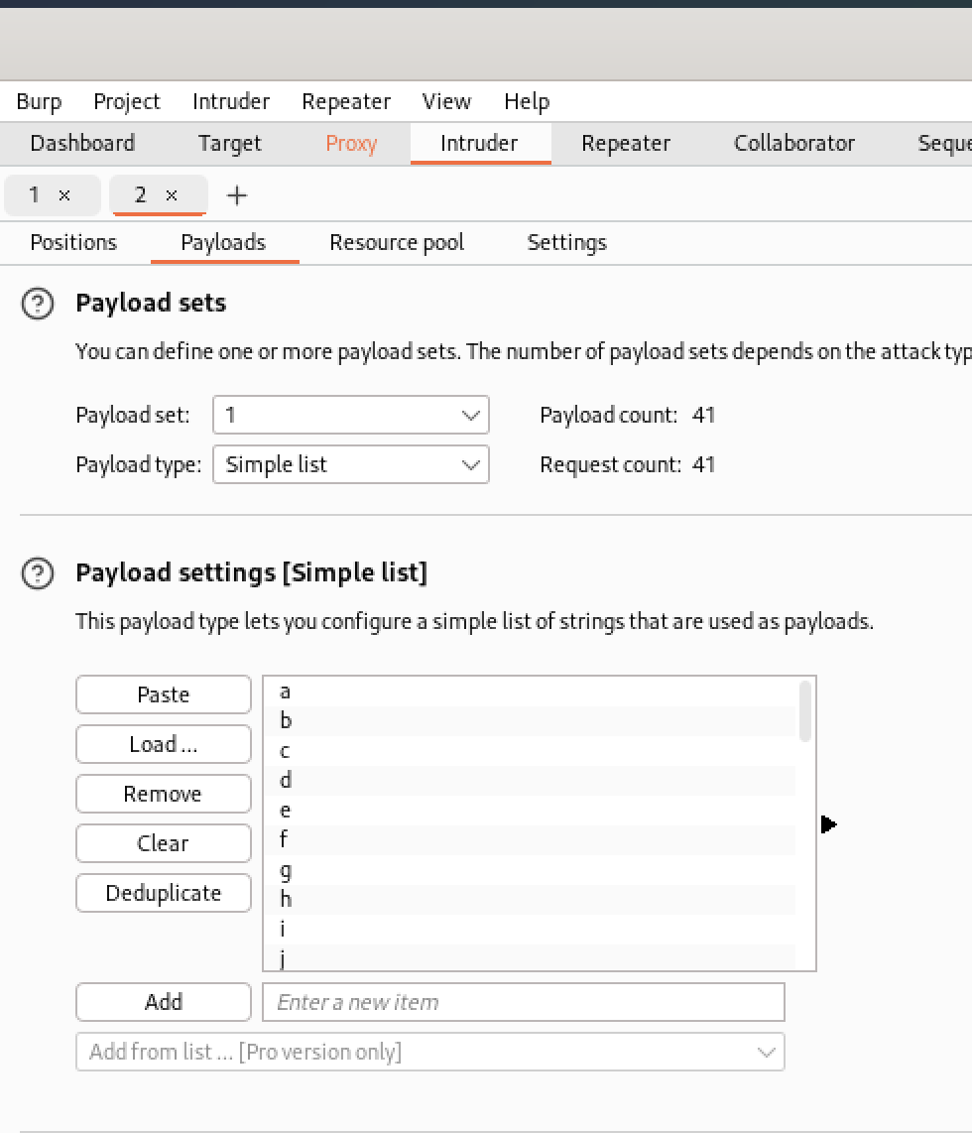
Step 3 — Payloads tab (purpose: give Intruder the guesses to try)
Click Payloads.
Payload type: Simple list.
If you used Character mode, paste this list (one per line):
a
b
c
d
e
.
.
.
w
x
y
z
0
1
.
.
.
8
9
_
-
.
@

Slide 46
Step 4 — (purpose: make Intruder wait long enough and not spam)
What you do:
Go to settings then set :
Set Thread count = 2–4 (low). Purpose: how many parallel requests Intruder will send. 2–3 is conservative and safe for lab.
Throttle between requests = 200 ms (0.2s).
  Why: small delay between requests prevents queueing and gives clearer timing differences.
Set Timeout = sleep_seconds + baseline + 2s.
Connect timeout: keep default (e.g., 2000 ms) — do not increase.
Normal response timeout: 10000 ms (10,000 ms). Why: covers SLEEP(5) + network jitter + margin.
Open‑ended responses: 20000 ms (20,000 ms). Why: only relevant if the server keeps the connection open for long streaming replies; safe higher value.
Leave other defaults.
Plain explanation: Intruder must wait longer than your SLEEP so requests that sleep are not aborted. Low threads avoid overloading the server and reduce WAF detection.
Step 5 — Start attack (purpose: run the guesses)
Click Start attack.
Let it run. It will send one request per payload.
Plain explanation: this automates hundreds of manual requests you’d otherwise send one by one.

Slide 47
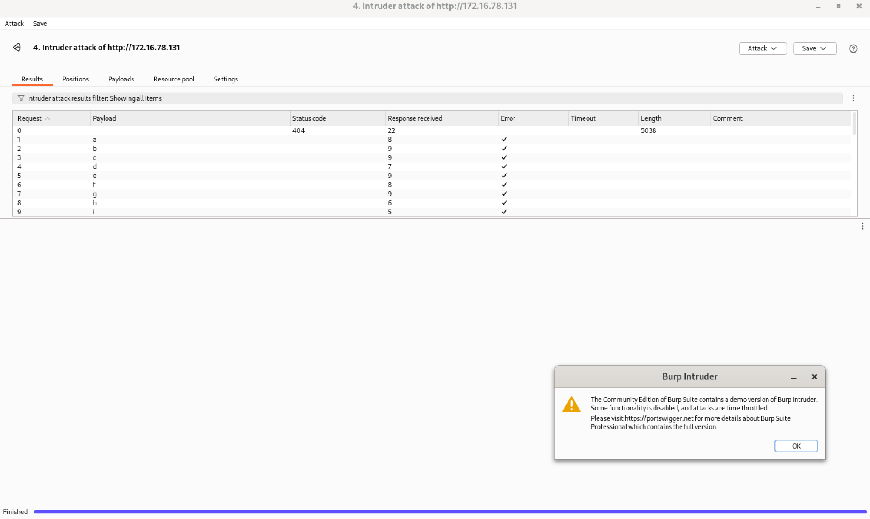

Slide 48
Step 6 — Interpreting results (purpose: find the slow response)
In the Intruder results table, click Response time header to sort descending.
The top row(s) with Response time ≈ baseline + SLEEP are candidates (the DB slept for the condition).
Plain explanation: a slow response indicates the condition evaluated true for that guess.
Step 7 — Confirm with Repeater (purpose: make sure it’s real)
Copy the HTTP of the top candidate from Intruder → right‑click → Send to Repeater.
In Repeater, press Send 2–3 times. You should consistently see the ~sleep delay only for the true guess.
Plain explanation: Intruder may show noise; Repeater confirmation avoids false positives.
Step 8 — Move to next character (purpose: build the string)
Edit the SUBSTRING index to 2,1 (for second character), then repeat Steps 2–7.
Example template for position 2:
1' AND IF(ASCII(SUBSTRING((SELECT database()),2,1))=ASCII('§'), SLEEP(5), 0) -- -
Plain explanation: each position is a new brute‑force round.

Slide 49
2. XSS ( Cross Site Scripting )
A web vulnerability that allows an attacker to inject malicious javascript code into a trusted website. When another user visits that page the browser executes the injected code.
XSS can be used to:
Steal cookies, session tokens, or credentials
Impersonate users
Redirect users to fake or malicious sites
Log keystrokes or capture form input
Deface websites or cause other damage
Three Types Of XSS:
Stored XSS : Malicious code is stored on the server (e.g., in a database) and shown to other users later.
Reflected XSS : Malicious code is immediately reflected back in a web response (URL or form input).
Dom Based XSS : Code is injected and executed entirely in the browser, without touching the server.

Slide 50
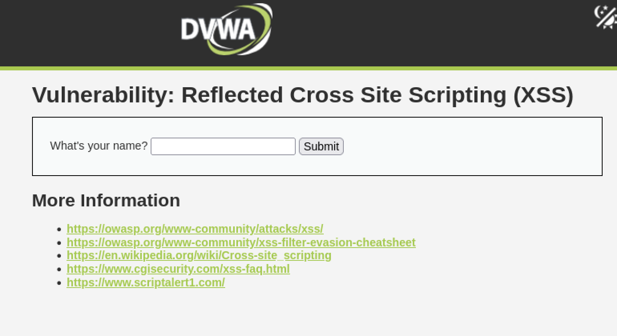
Objective : Steal the cookie of a logged in user.
First we will perform reflected XSS.

Slide 51
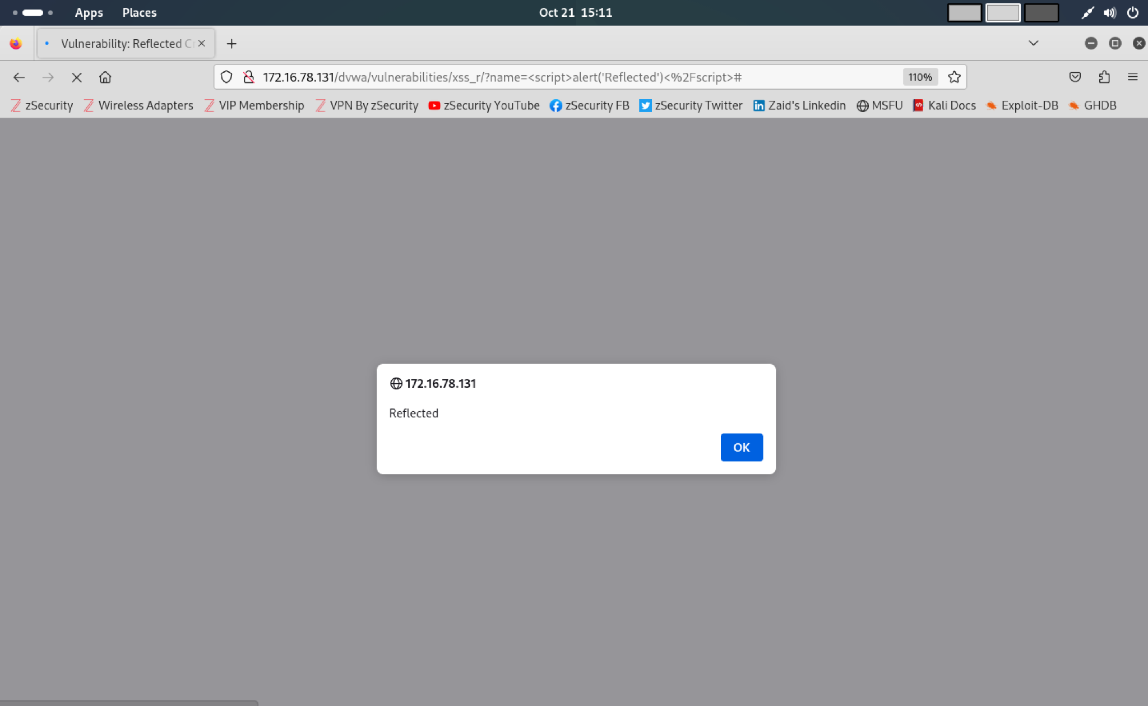
In the input box (or URL parameter) insert the payload: <script>alert('Reflected')</script>

Slide 52
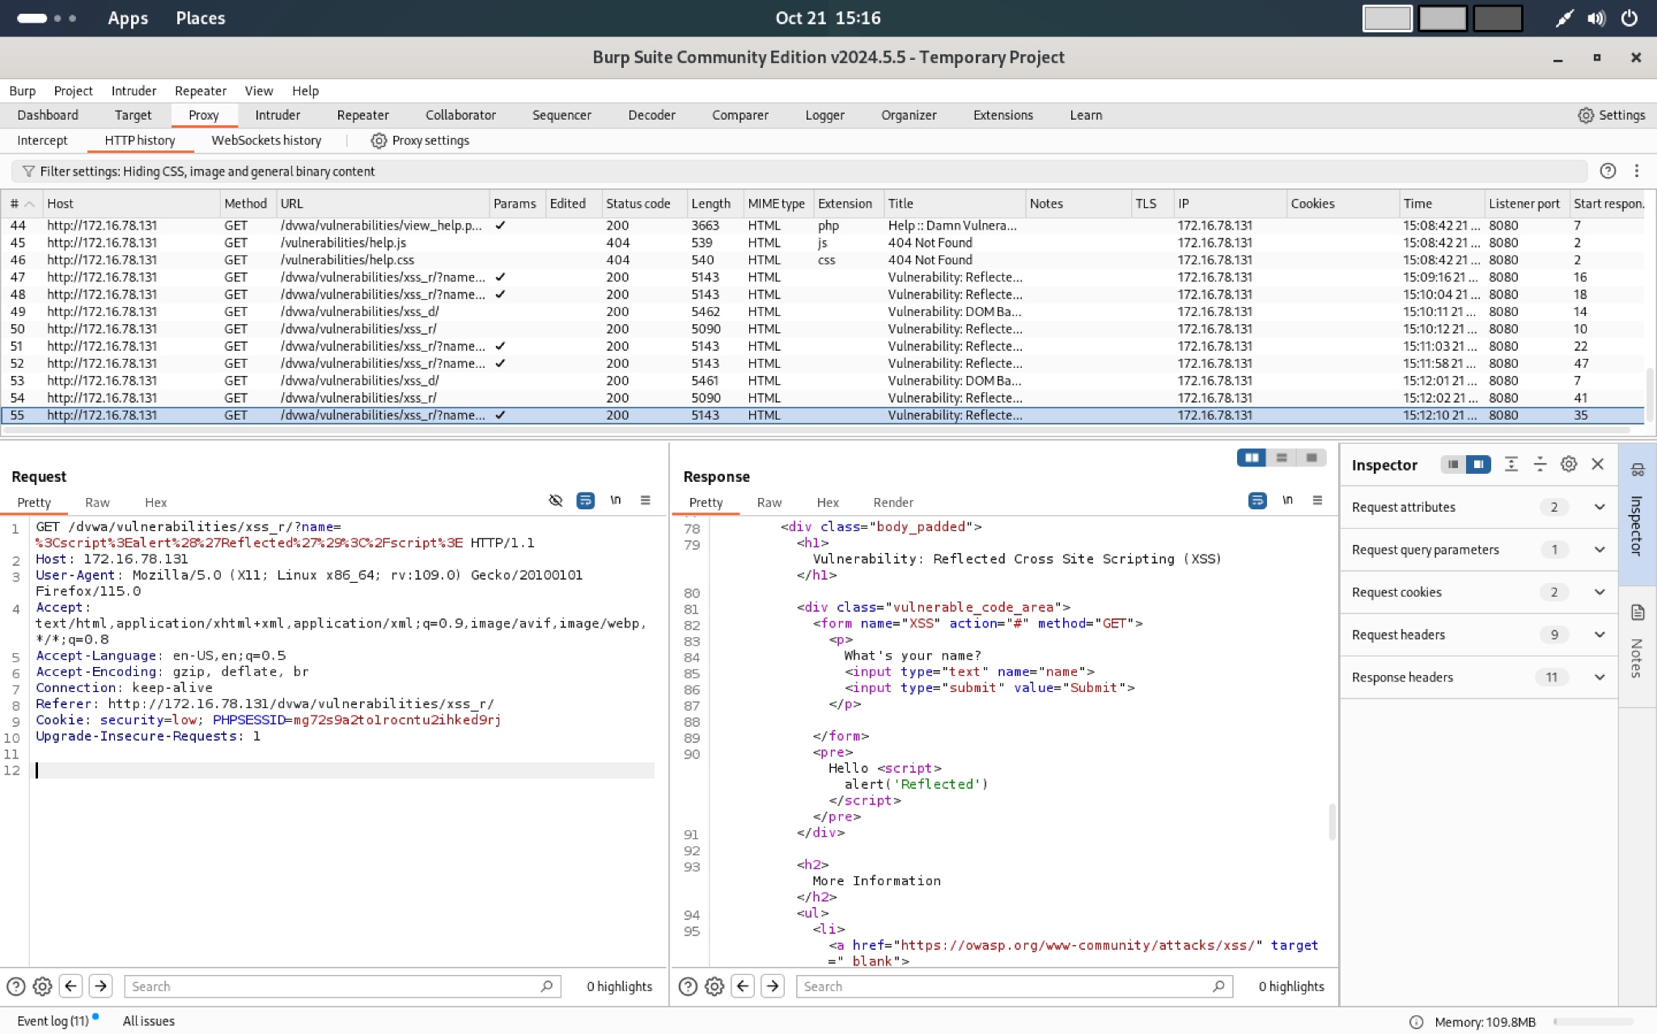
Capture the request/response in Burp:
Turn Intercept ON in Burp.
Submit the form. Burp will show the POST (or GET) request with the parameter.
In Burp → Intercept → Forward the request to the server.
In Burp → HTTP history, open the response and show the HTML where your payload appears unescaped.

Slide 53
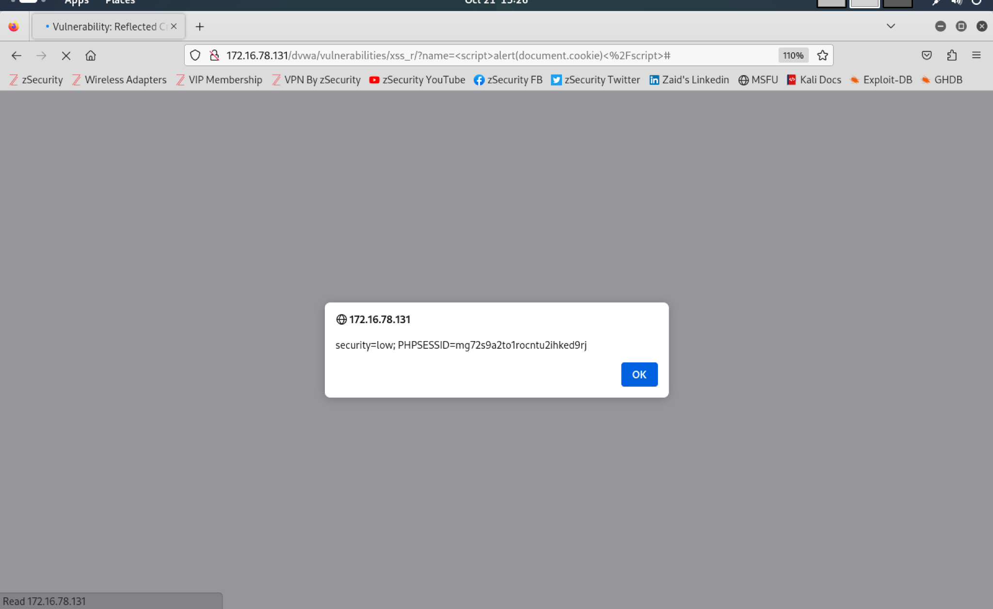
Now since we demonstrated how to inject javascript code, we will try to steal the cookie using another method that is by using document.cookie

Slide 54
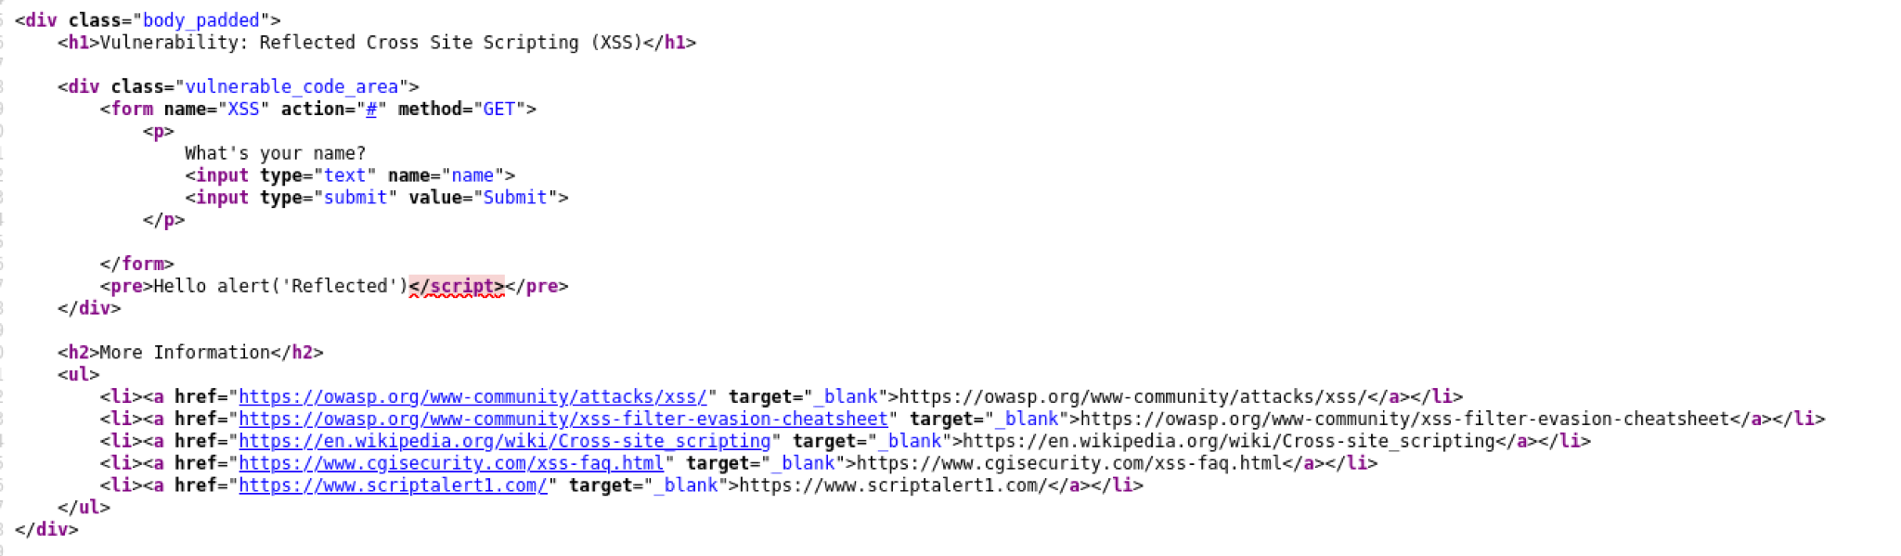
What we did earlier was low level since requested input was not checked, before including it to be used in the output text.
But what if the the developer has tried to add a simple pattern matching to remove any references to "<script>", to disable any JavaScript. Then <script>alert(document.cookie)</script> will not work.
First we will provide <script>alert('Reflected')</script> in the input box as shown earlier then view the page source to inspect the code.

Slide 55
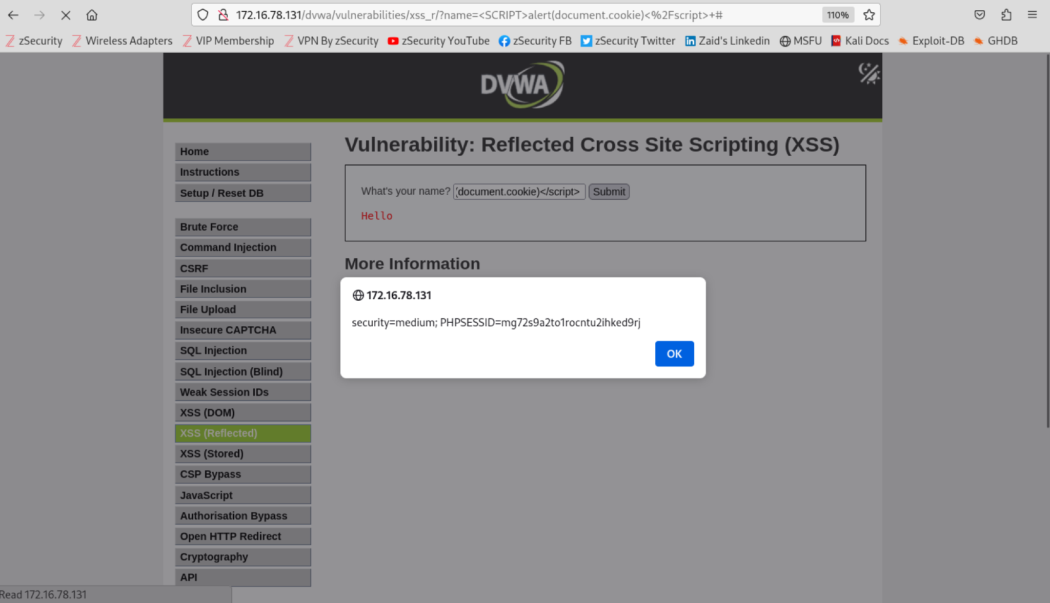
After viewing the page source we saw that the starting script tag is removed but the ending script tag is not removed.
So we will try a couple options to extract the cookie.
First we will try <SCRIPT>alert(document.cookie)</script>
Then we will try <scr<script>ipt>alert(document.cookie)</script>
Both of the methods worked.
The second one worked since the program of the website is programmed to delete the word <script> so it will read <script> from the second method and delete it. So the program would become.
<script>alert(document.cookie)</script>

Slide 56
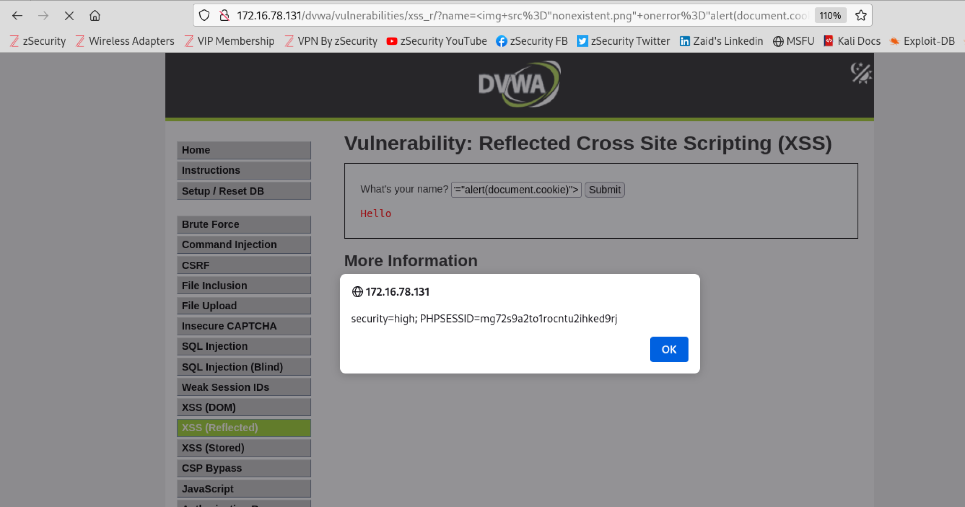
Next what if they have programmed the website in a way that the developer now believes they can disable all JavaScript by removing the pattern "<s*c*r*i*p*t".
Then we can use <img src="nonexistent.png" onerror="alert(document.cookie)">
src="nonexistent.png" — the browser will fail to load that image (so the error event fires).
onerror="..." — the contents are executed as JavaScript when the error event occurs.
alert(document.cookie) — shows whatever cookies are readable by JavaScript for that page.

Slide 57
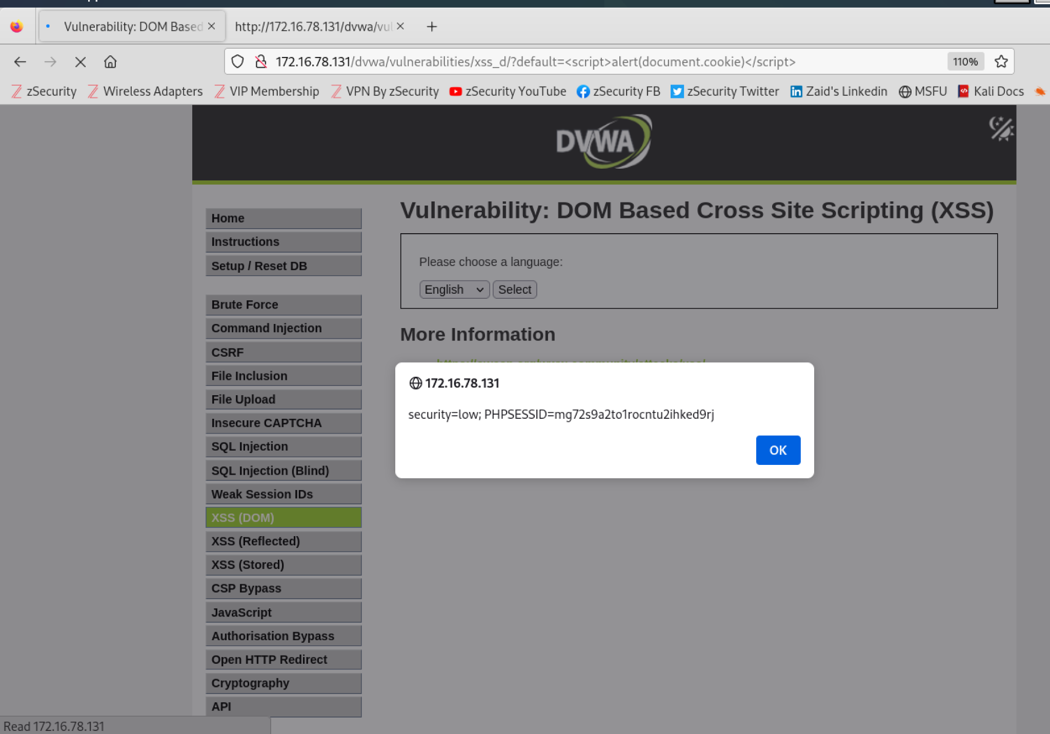
Next we will perform XSS (DOM)

Slide 58
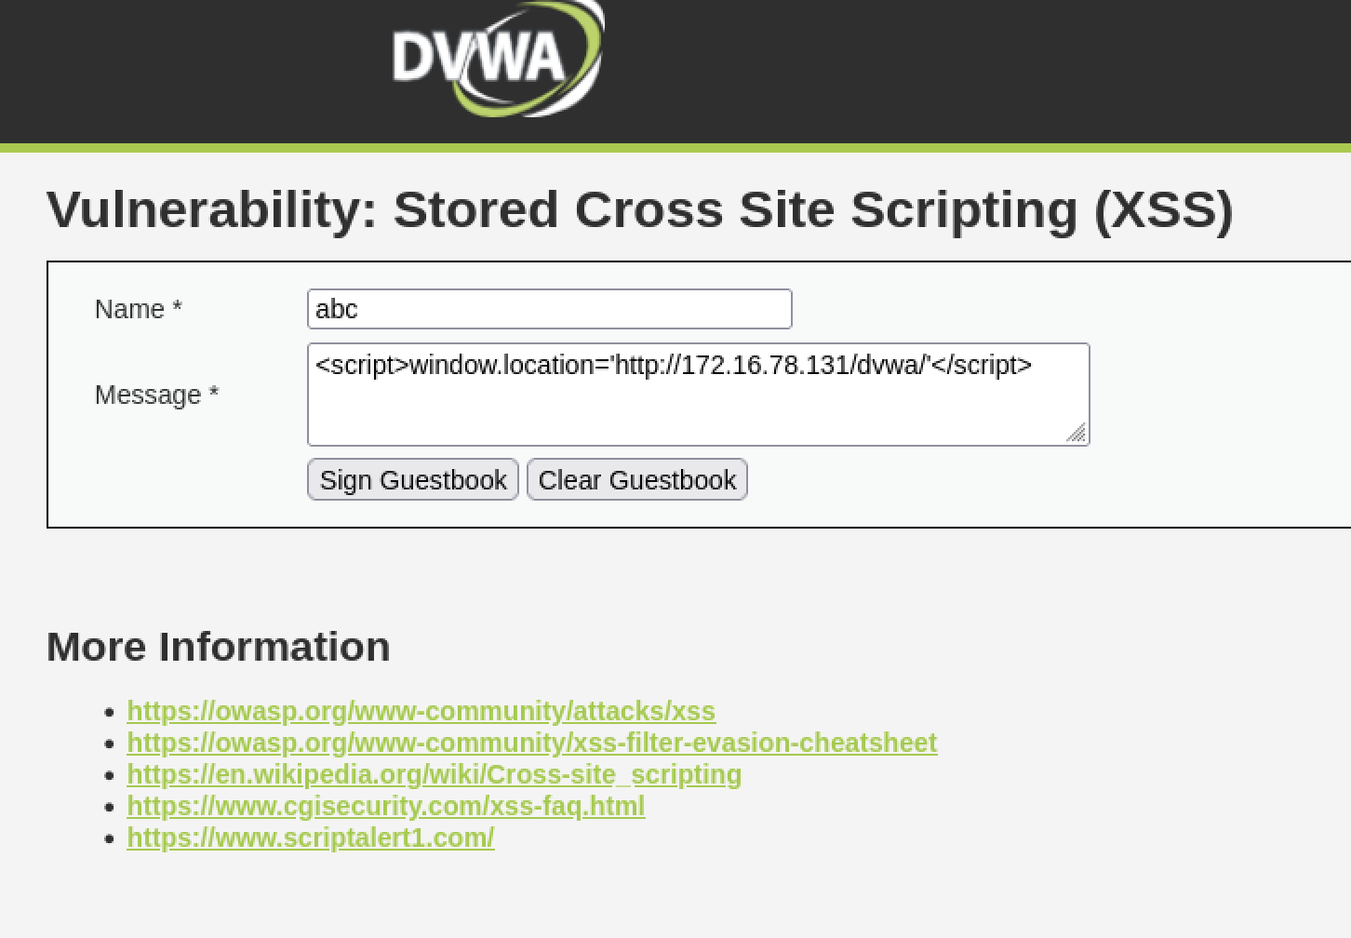
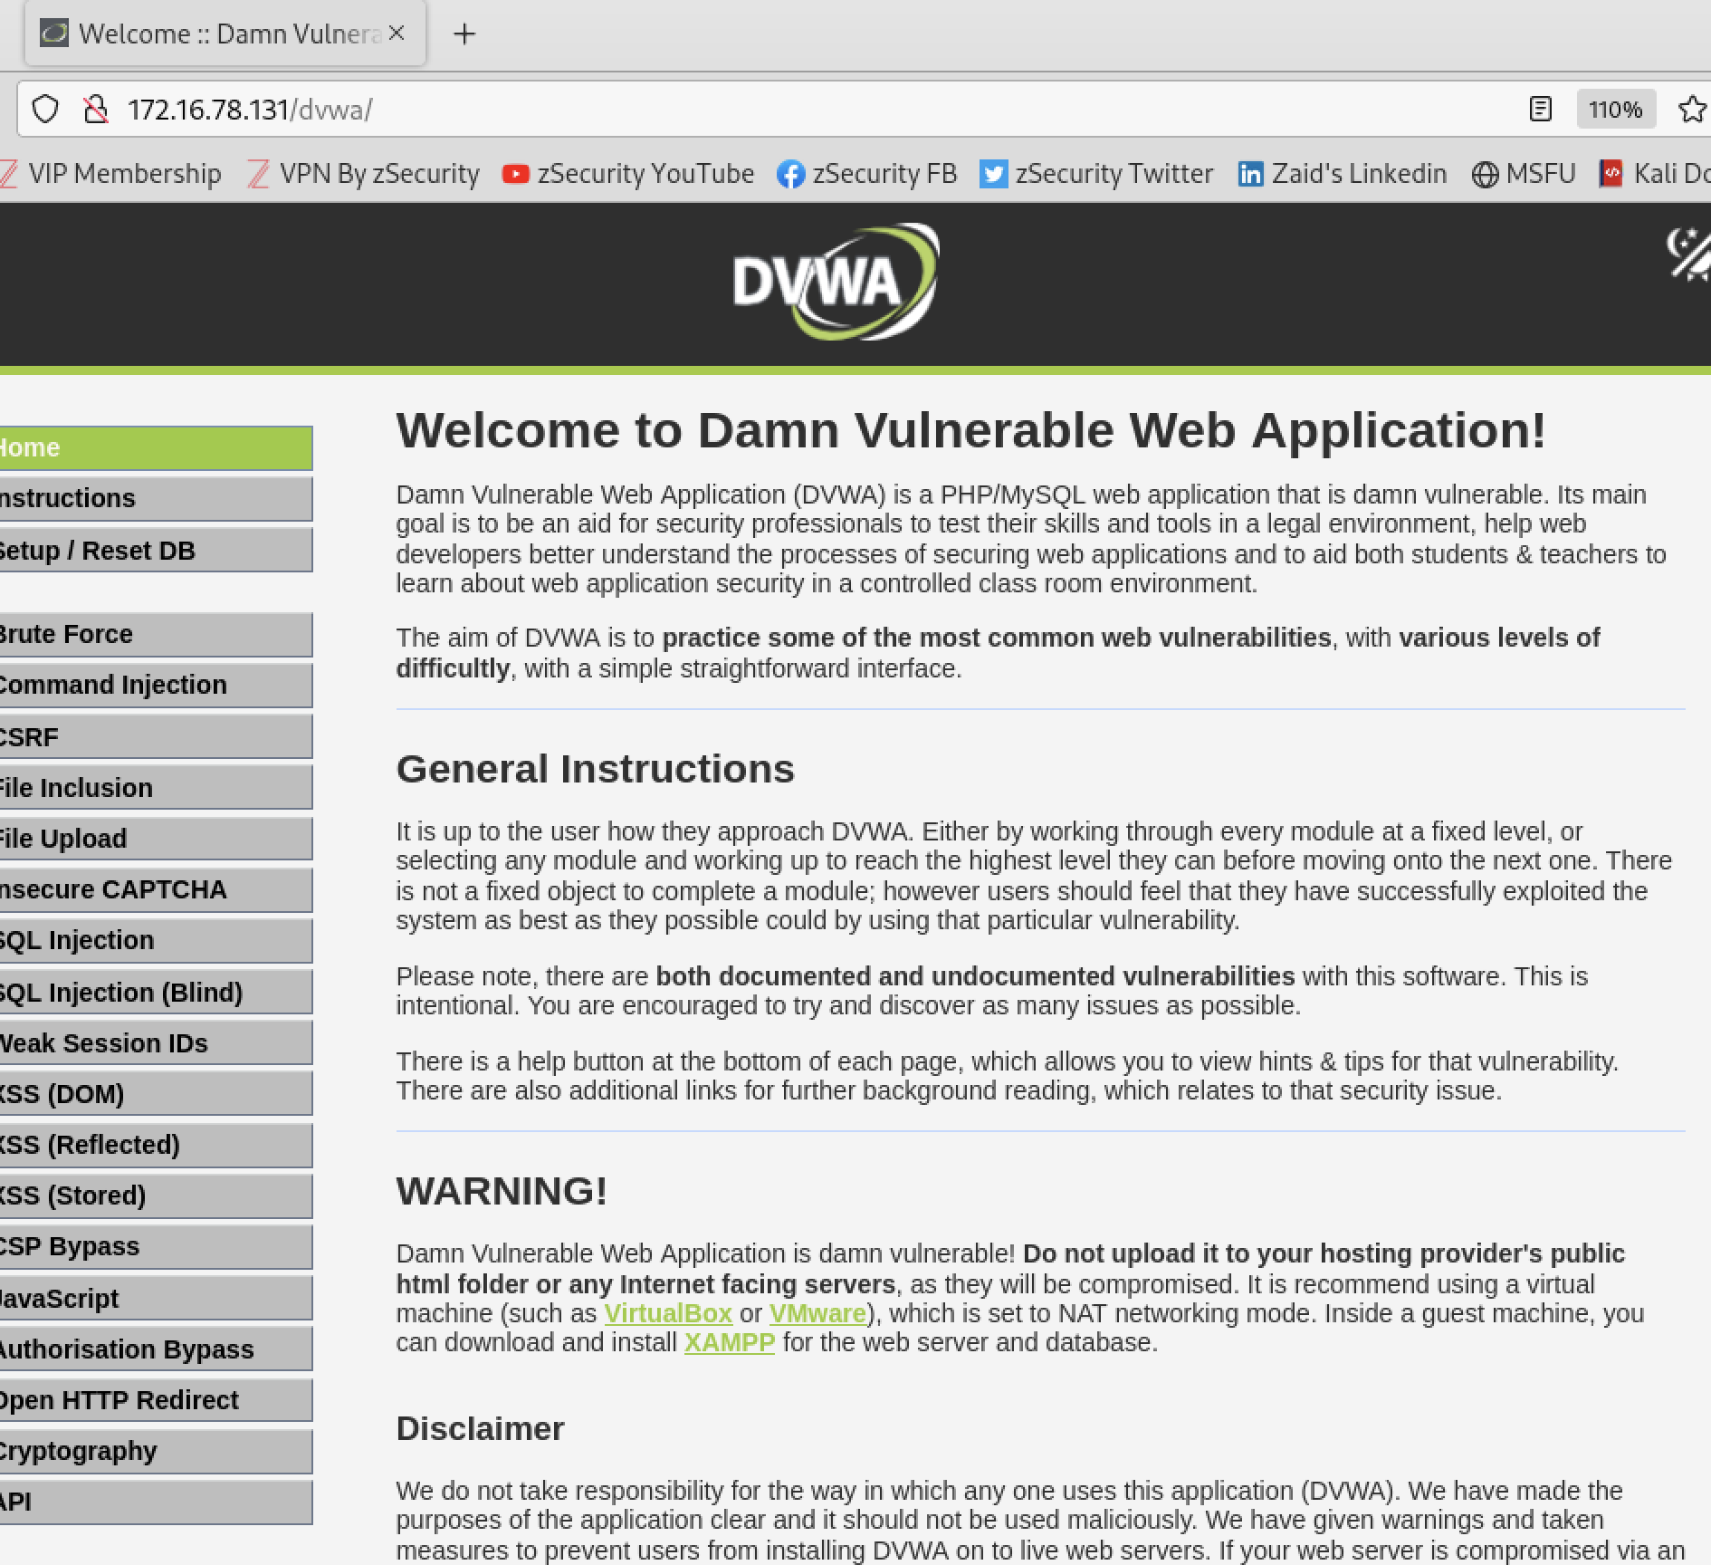
At last we will perform XSS (Stored)
Objective : Redirect everyone to a web page of your choosing.
First we will start with the low level so will not check the requested input, before including it to be used in the output text.
Got redirected to

Slide 59
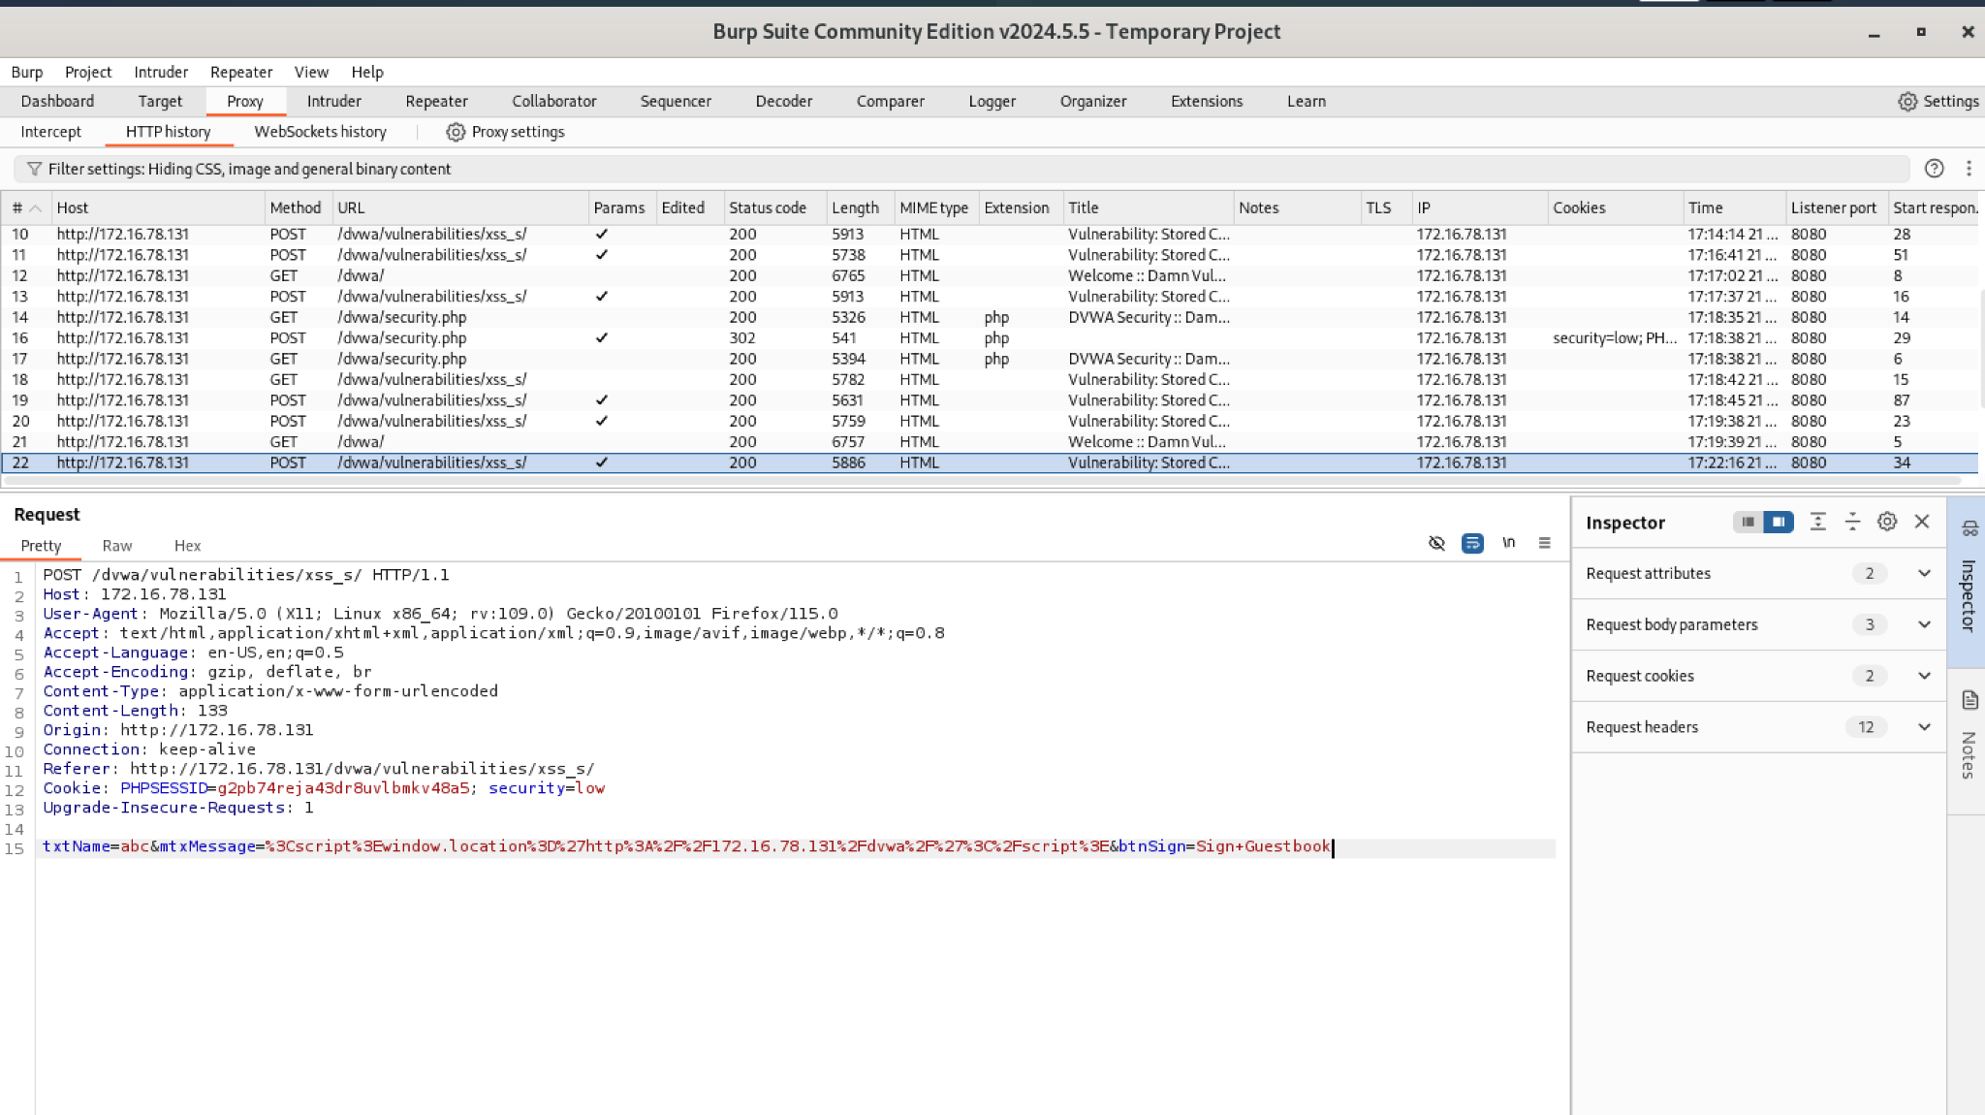

Slide 60
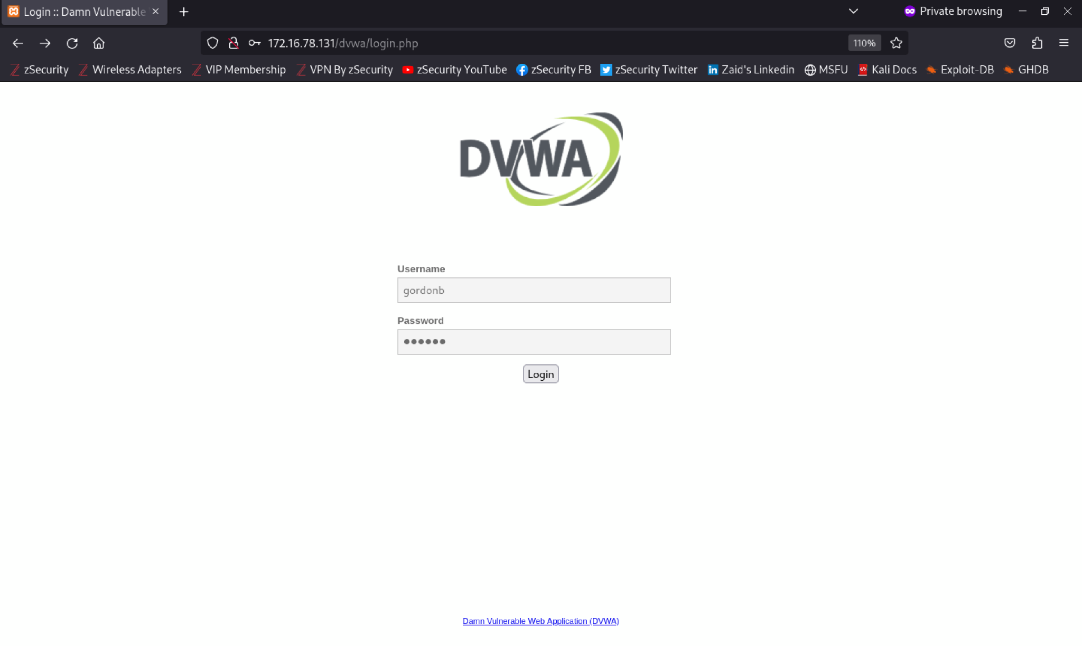
Impact: Arbitrary JavaScript execution in other users’ browsers, forced redirects, and potential exposure of cookies or sensitive data if not properly protected.
So now even though I logged in using a different account in a private window whenever I click XSS (stored) it gets redirected to the url I specified earlier. That means the page I clicked is being served with the malicious script in it — the payload was persisted by the server and is executed when another session/viewer interacts with that stored content. That is the definition of stored (persistent) XSS.

Slide 61
Where XSS can run (beyond <script>)
1) HTML body context : When input is inserted between tags.
Example: the site outputs Hello, USER_INPUT into the page body.
Payload:
<script>alert(1)</script>
2) Attribute context (inside an attribute value)
Input placed inside value="...", href="...", src="...".
Example payloads: " onmouseover="alert(1) ' onfocus='alert(1)
Resulting HTML might become: <input value="" onmouseover="alert(1)">
3) Event handler attributes
onclick, onerror, onload, etc.
Example: <img src=x onerror=alert(1)>
4) URL / protocol context
Input used in href, src, location, window.open.
Example: <a href="javascript:alert(1)">click</a>
5) JavaScript context (inside a JS string or code)
Input put inside <script>var a = 'USER';</script>.
Example payload to break out of string: ');alert(1);//
Becomes: var a = '';alert(1);//';
6) DOM-based XSS (client-side)
The client-side JS reads location, hash, document.referrer, or user input and uses innerHTML, document.write, eval, etc.
Example URL: http://site/?q=<script>alert(1)</script>
If client JS does el.innerHTML = location.search.substring(3), the script executes.

Slide 62
7) SVG & XML contexts
SVG elements support event handlers and can contain script.
8) CSS / style injection (less common but possible)
Input injected into <style> or style attribute might be abused (or cause behavior changes).
Example (older or exotic browsers): CSS expression() or url(javascript:...) (rare/blocked in modern browsers).
9) srcdoc / iframe / data URI
Inserting user data into an iframe srcdoc or data URI can run HTML/JS.
Example: <iframe srcdoc="USER_INPUT"></iframe>

Slide 63
What can happen if cookies/session cookies are stolen
Account takeover / impersonation
A session cookie often represents an authenticated session. If an attacker can present that cookie to the server, the server may treat them as the legitimate user and allow actions as that user (viewing private data, posting, changing settings).
Impact level: high for accounts with sensitive data or privileged access.
Data exfiltration & privacy breach
The attacker can read whatever the compromised account can access: messages, personal info, financial data, private repositories, etc.
Actions on behalf of the user
Posting content, sending messages, making purchases, or changing account settings (email/phone/password) — depending on what the webapp allows and whether additional checks are in place.
Chaining into other attacks
An attacker may use the account to send phishing, escalate within an organization, or gather information that enables further compromise (social engineering, privilege escalation).
Session replay across devices
If session tokens aren’t bound to client properties, they may be valid from any location and device, enabling remote misuse.
Persistent access via stolen persistent cookies
If persistent cookies (with long expiry) are stolen, access can last long unless server-side invalidation occurs.
Abuse of linked services
Accounts often have API access or connected services — those can be abused too (e.g., cloud console, payment services) if tokens permit.
Reputational / legal / financial damage
For individuals and organizations: reputational loss, compliance breaches, financial losses, regulatory fines.
What limits the attacker’s abilities
Server-side protections — e.g., re-authentication for sensitive actions (enter password / 2FA) can limit damage.
Cookie flags — HttpOnly, Secure, and SameSite mitigate common theft vectors.
Session binding — tying session to IP, device fingerprint, or user-agent reduces replay (but can harm UX).
Short lifetimes and rotation — short session TTLs and rotating tokens limit exposure window.

Slide 64
3. Authorisation Bypass
Authorization bypass is a type of security vulnerability where an attacker can gain access to resources, functions, or data that they should not be allowed to access, by circumventing the normal access control mechanisms.
1. Authorization vs Authentication
Authentication: Verifies who you are (e.g., logging in with a username and password).
Authorization: Determines what you are allowed to do (e.g., can you view another user’s profile or admin dashboard).
Authorization bypass specifically targets the authorization step.
2. How Authorization Bypass Happens
Some common ways include:
Manipulating URLs or parameters
  Example: Accessing another user's data by changing user_id=123 to user_id=124 in the URL.
Changing cookies or tokens
  If session tokens encode your role, modifying them could give admin access.
Skipping front-end checks
  Only front-end controls exist (like hiding a button), but back-end doesn’t enforce permissions.
Accessing APIs directly
  Calling API endpoints that require higher privileges without proper checks.

Slide 65
a) Authorization matrices
Developers use authorization matrices to define who can do what in a system.
Example:
| User Type | View Profile | Edit Profile | Delete User |
|----------------|-------------|-------------|-------------|
| Regular | ✅ | ❌ | ❌ |
| Admin | ✅ | ✅ | ✅ |
In complex systems with many roles and features, it’s easy for developers to forget to implement a check somewhere.
b) Hidden or indirect access
Some functions are not accessed through the browser directly, like APIs or background services.
If a developer forgets authorization here, an attacker could exploit it.
Example:
Browser shows a “View Orders” page.
API call: GET /orders/456
If the server doesn’t check whether the current user owns order 456, another user might access it directly via the API.
c) Tester’s job
Testers must look at all possible system calls:
  Browser requests
  API calls
  Background services
And then test each call with every type of user to make sure they can only do what’s allowed.

Slide 66
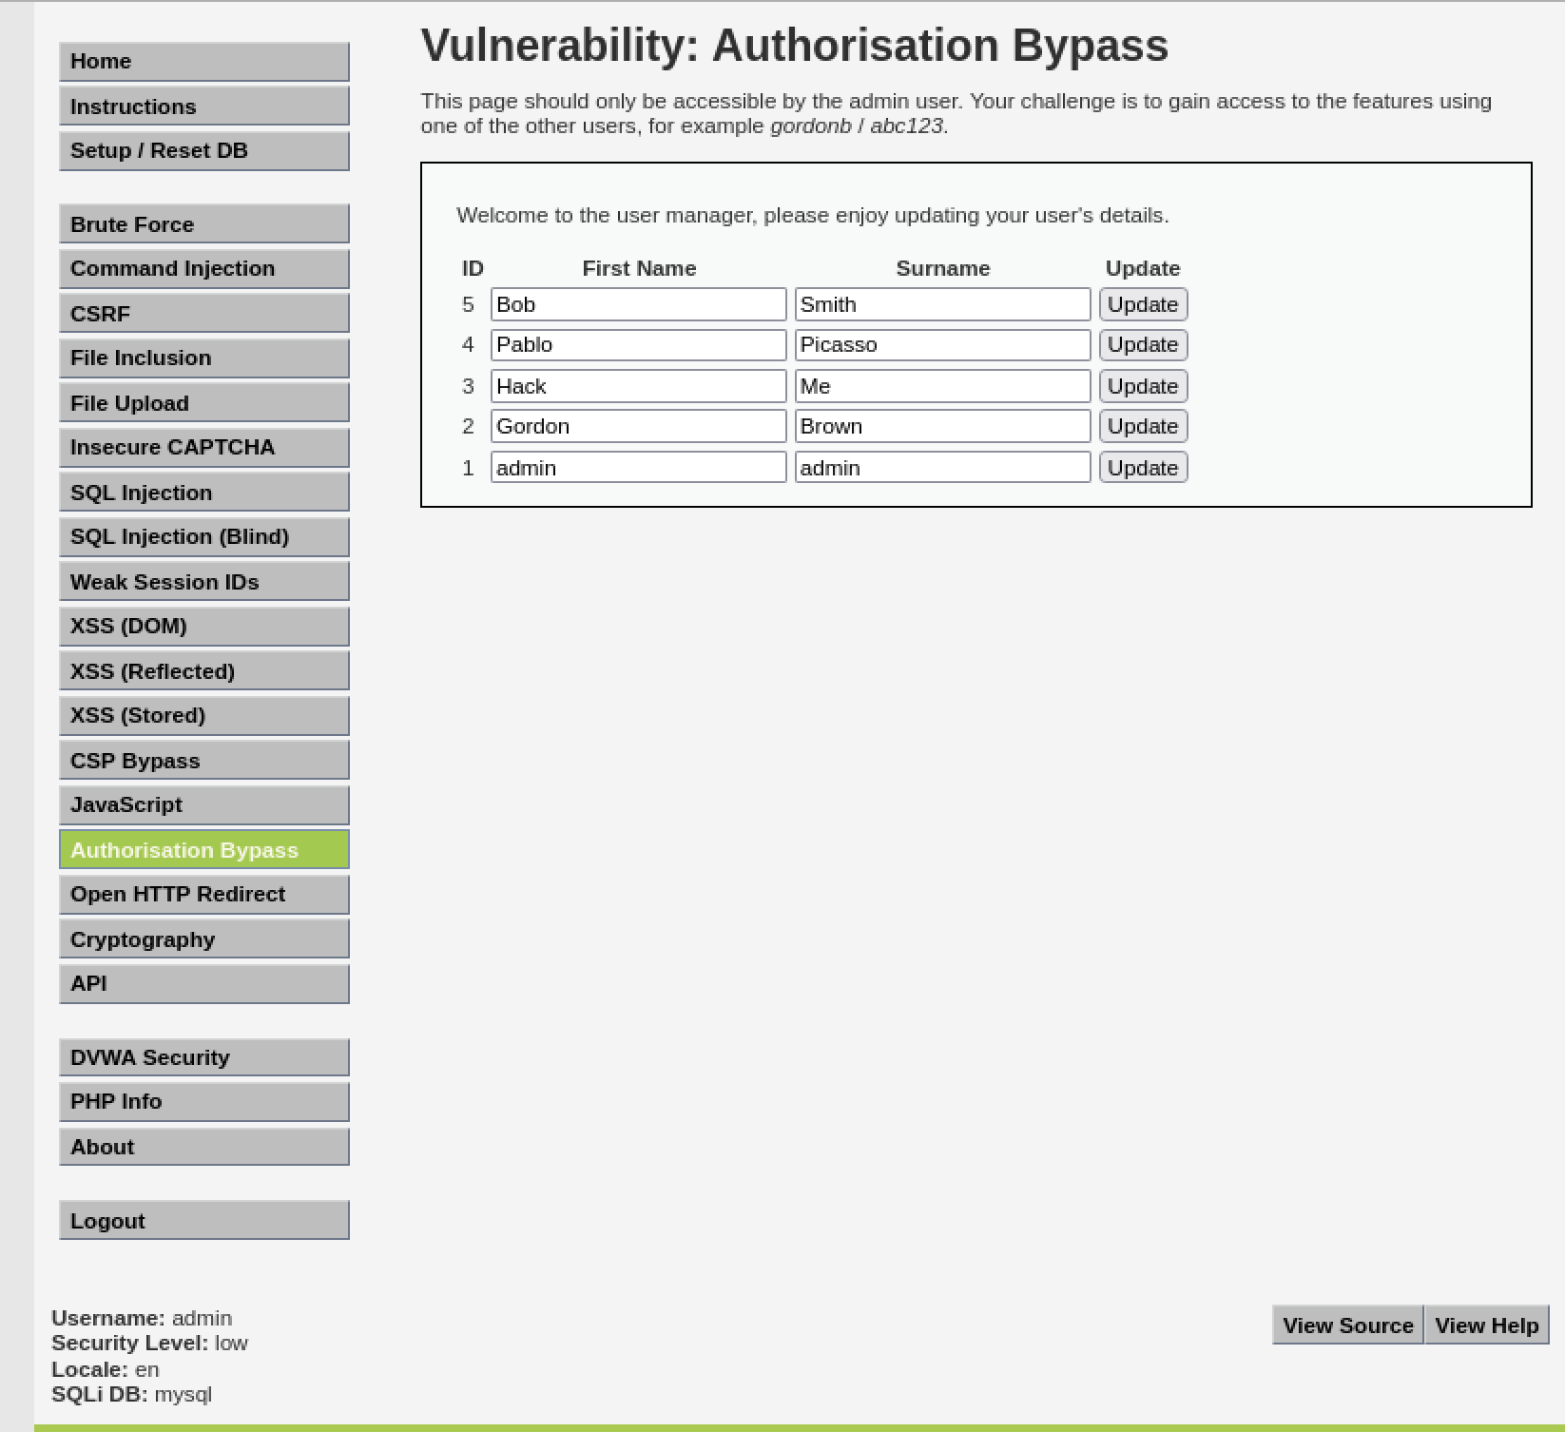
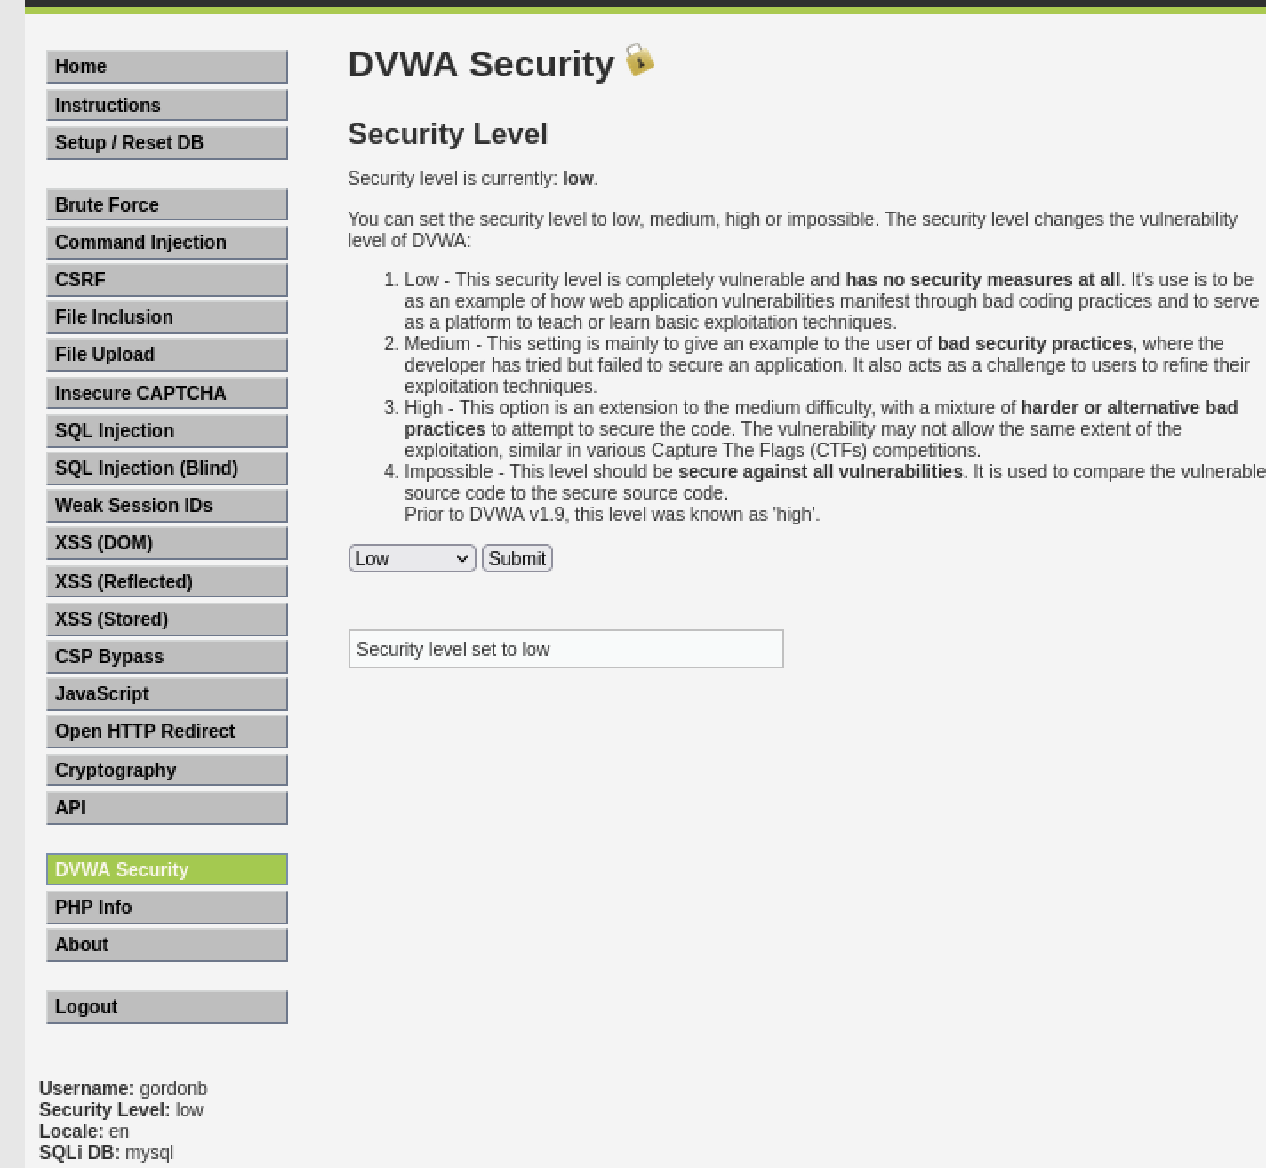
Objective : This page should only be accessible by the admin user. Your challenge is to gain access to the features using one of the other users, for example gordonb / abc123.
Firstly this lab is only accessible by admin user it won’t be visible in any other user. So we will login as gordonb in a private window

Slide 67
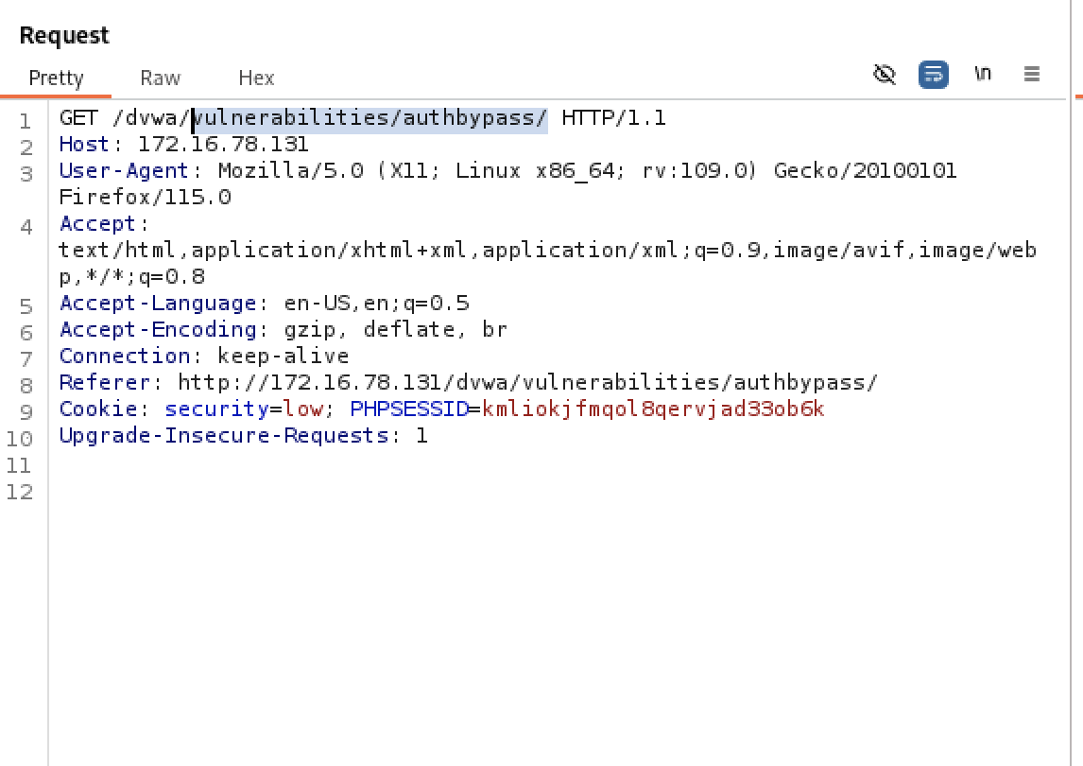
So burp suite had intercepted a get request when i logged in as admin so using this url and pasting it in the private window gets us authorised to access that page.

Slide 68


Slide 69

Earlier we had access to the html of the page. What if the user blocked the access of html then how can we see the page
Get request for this will be shown in the burp. we can try to see if other request types are blocked as well or not.

Slide 70


Since other request types are also forbidden or unauthorised we will try another method.

Slide 71


Next we can try is to change the request method to POST. But as seen that didn’t pass the authorisation as well.
Since none of them works what we can do is we can look into burp suite http history there we will get admin account get request where the users were shown we will try to access that.

Slide 72

So we basically tried to access the file. We get this data directly back from the API. We can see it but we can’t interact with it or change it.

Slide 73
Post-Test Cleanup:
Since the assessment was performed on the DVWA lab within a virtual environment, all changes were automatically reverted after the session ended. No real systems were affected. The DVWA database was reset using the built-in “Setup / Reset DB” option to restore the default state.

Slide 74
Methodology
This assessment followed a structured four-stage web application penetration testing methodology, applied consistently across every vulnerability class tested in this project:
1. Reconnaissance & Mapping
Enumerate open ports, running services, and application endpoints (Nmap) and build a full map of pages, parameters, and HTTP methods (Burp Suite HTTP History) before any exploitation begins.
2. Vulnerability Identification
Probe each discovered input/parameter with safe test payloads to confirm whether a vulnerability class (SQLi, XSS, broken access control) is actually present, before attempting full exploitation.
3. Exploitation
Manually exploit the confirmed vulnerability first, to build a genuine understanding of the flaw, then (where applicable) automate repetitive extraction using Burp Intruder.
4. Reporting & Remediation
Document each finding with evidence (request/response captures), assess real-world impact, and map every finding to a concrete, actionable fix.
This mirrors the standard methodology used in industry VAPT engagements (e.g. PTES / OWASP Testing Guide phases), and was applied identically whether the target vulnerability was SQL injection, XSS, or an authorization flaw.

Slide 75
Remediation — SQL Injection
The root cause of every SQL injection variant demonstrated in this project (in-band, boolean-blind, and time-blind) is the same: untrusted input concatenated directly into a SQL query. The fix is therefore identical across all three.
Parameterized queries / prepared statements: never concatenate user input into SQL strings; bind parameters instead so input can never alter query structure.
ORM / query builder: use a framework that enforces parameter binding by default rather than raw string-built SQL.
Least-privilege database accounts: the application's DB user should not have access to information_schema or any tables/actions it doesn't need.
Server-side input validation: allow-list expected formats (e.g. numeric IDs) and reject anything outside that shape before it reaches the query layer.
Generic error messages: never return raw SQL errors or database structure to the client.
Query timeouts: limit how long a query may run, so SLEEP()-style timing payloads cannot be used as a reliable blind-injection oracle.
Defence in depth: a Web Application Firewall (WAF) can catch common injection patterns, but is a supplement to fixing the code, not a substitute.

Slide 76
Remediation — Cross-Site Scripting (XSS)
Because XSS payloads were shown to execute through multiple contexts (HTML body, attributes, event handlers, and pure client-side DOM sinks), the fix must be context-aware rather than a single filter.
Context-aware output encoding: HTML-encode, attribute-encode, or JavaScript-encode user data according to exactly where it is rendered on the page.
Content Security Policy (CSP): restrict script execution to trusted sources; blocks most injected inline scripts even if a filter is bypassed.
Allow-list sanitization, not denylist filtering: this project showed that blacklisting the literal string "<script>" is trivially bypassed (case variation, nested tags, onerror handlers) — use a maintained library such as DOMPurify or framework auto-escaping instead.
HttpOnly cookie flag: prevents client-side JavaScript from reading session cookies via document.cookie, even if an XSS flaw exists.
Secure and SameSite cookie flags: reduce cookie theft and cross-site replay risk.
Safe DOM APIs: for DOM-based XSS specifically, avoid innerHTML / document.write / eval() on user-influenced data; use textContent / createElement instead.
Step-up authentication: require re-authentication (password / 2FA) for sensitive account actions, limiting the impact of a stolen session

Slide 77
Remediation — Authorization Bypass
The authorization bypass demonstrated in this project succeeded because the restricted function was hidden from the UI but not actually protected server-side — the captured admin request worked when replayed by a low-privileged user.
Enforce authorization server-side, on every request: for every role/permission combination — never rely on hiding UI elements as the only control.
Formal authorization matrix: define role x resource x action during design, and test every combination during QA/security testing, not just the expected path.
Object-level ownership checks: verify the logged-in user actually owns the requested record (e.g. order_id) before returning it, to prevent IDOR.
Consistent enforcement across all access paths: apply identical checks to browser pages and to API/back-end endpoints — attackers do not need a browser.
Deny-by-default: access should be explicitly granted per role, rather than explicitly denied for exceptions.
Logging and alerting: flag repeated authorization failures or access attempts outside a user’s normal pattern.

Slide 78
Findings Summary
Summary of every vulnerability class identified and exploited during this assessment, mapped to the OWASP Top 10 (2021):
SQL Injection - in-band (UNION-based): A05: 2025 Injection | Critical | full database disclosure via Burp Repeater
SQL Injection - blind (boolean & time-based): A05: 2025 Injection | Critical | data extracted via manual + Burp Intruder automation
Weak password hashing (unsalted MD5): A04: 2025 Cryptographic Failures | High | cracked offline with John the Ripper
Cross-Site Scripting - Reflected: A05: 2025 Injection (XSS) | High | manual payload injection
Cross-Site Scripting - Stored: A05: 2025 Injection (XSS) | Critical | verified across separate user sessions
Cross-Site Scripting - DOM-based: A05: 2025 Injection (XSS) | High | client-side sink analysis
Authorization Bypass / Broken Access Control: A01: 2025 Broken Access Control | High | captured admin request replayed by a low-privileged user
(Severity ratings are illustrative, based on general OWASP guidance for these vulnerability classes in a typical production context; DVWA itself is a deliberately vulnerable lab application, not a production system.)

Slide 79
Future Scope — Blue Team / SIEM Extension
This project currently demonstrates the offensive (red team) half of the security lifecycle. The planned next phase closes the loop by building the corresponding defensive (blue team) capability in the same lab.
●SIEM integration: forward DVWA / web server and Burp-generated attack traffic logs into a SIEM (e.g. Wazuh, Splunk, or the ELK stack).
●Detection rules for each attack demonstrated in this project: repeated UNION SELECT / information_schema keywords; abnormal response-time variance on one endpoint (blind SQLi signature); <script>, onerror=, javascript: patterns in submitted fields; requests to admin-only endpoints from non-admin sessions.
●Real-time log analysis & threat hunting: actively hunt through the generated attack traffic to validate detection coverage, rather than relying on alerts alone.
●Measurable detection rate: report a detection rate for each of the four attack classes in this project, closing the loop between "I can exploit this" and "I can detect this being exploited."

